Slide 1
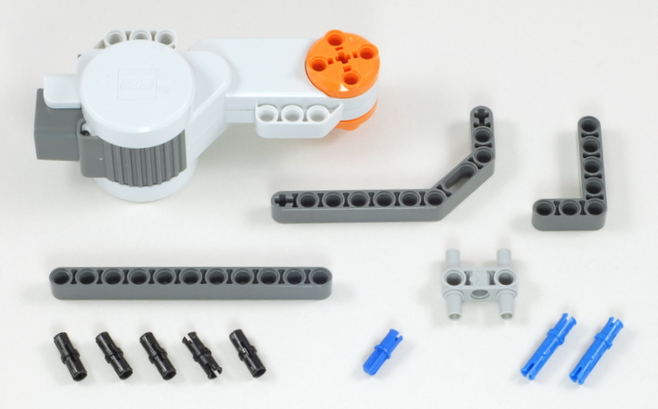
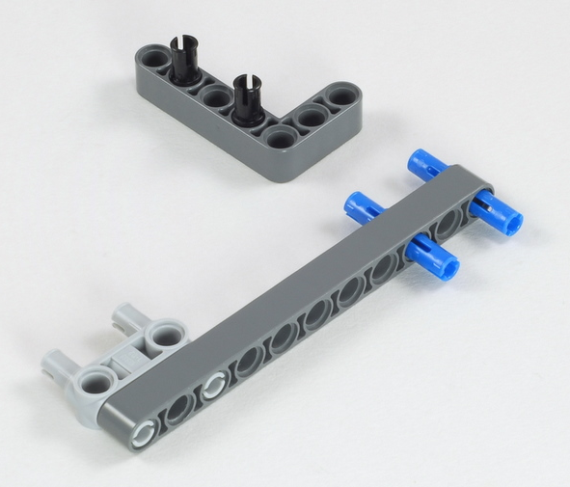
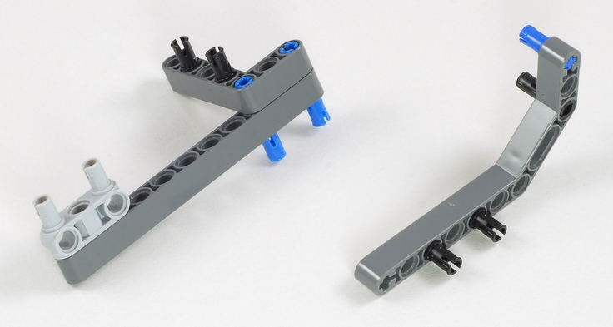
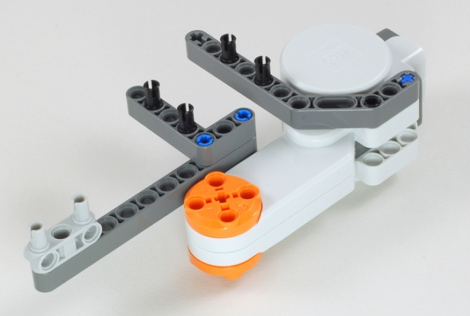
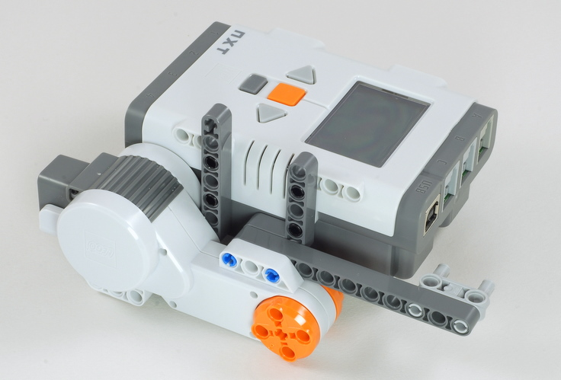
Express-Bot
Driving Base
Step-by-Step Instructions
1. Right Side
11
The Express-Bot design may be freely used and redistributed. Design by www.nxtprograms.com.

Slide 2
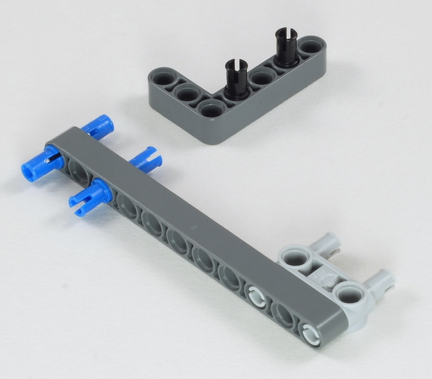
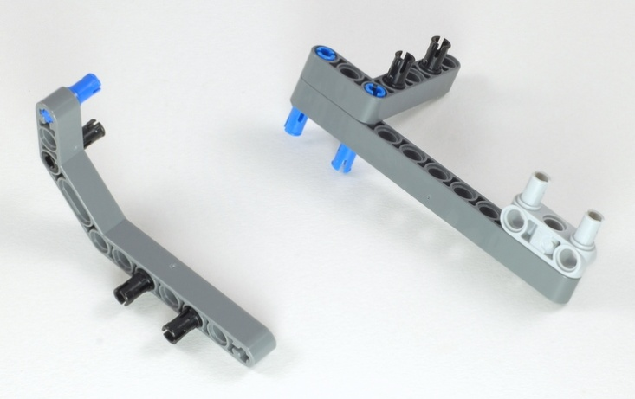
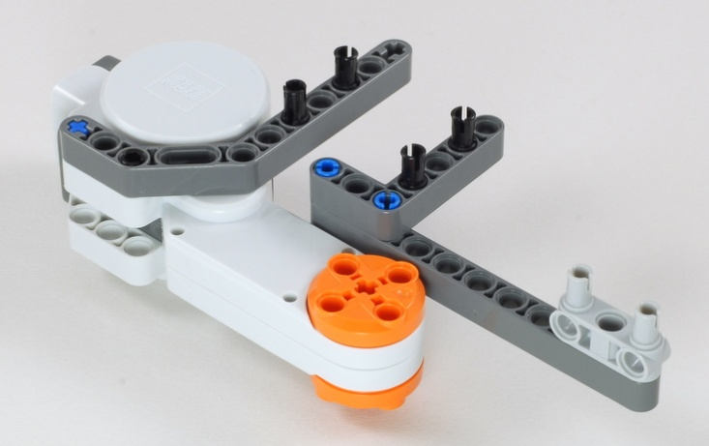
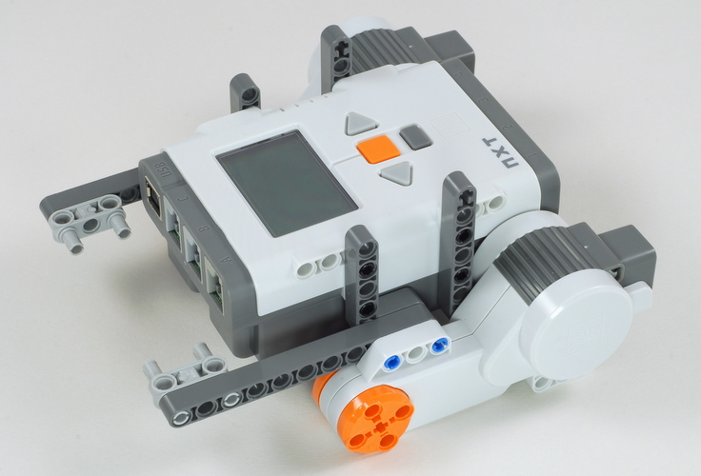
Express-Bot
Driving Base
Step-by-Step Instructions
2. Left Side
11
The Express-Bot design may be freely used and redistributed. Design by www.nxtprograms.com.

Slide 3
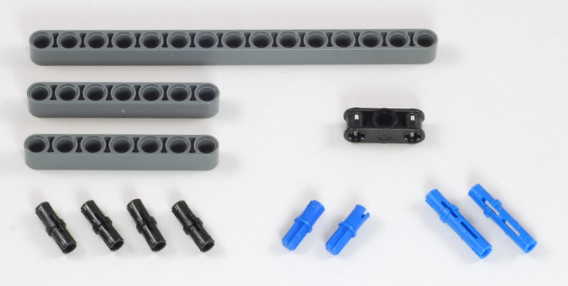
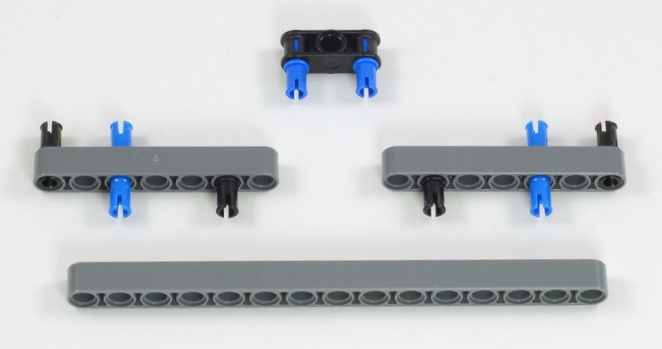
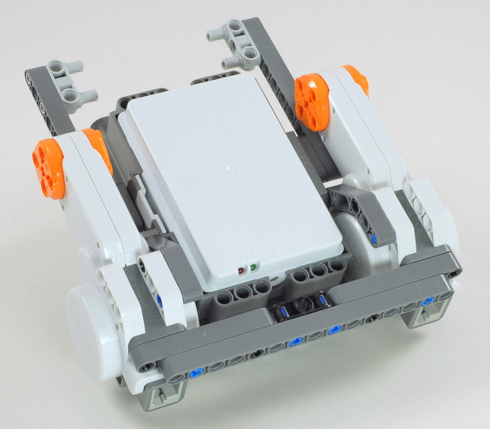
Express-Bot
Driving Base
Step-by-Step Instructions
3. Rear Frame
15
7
7
The Express-Bot design may be freely used and redistributed. Design by www.nxtprograms.com.

Slide 4
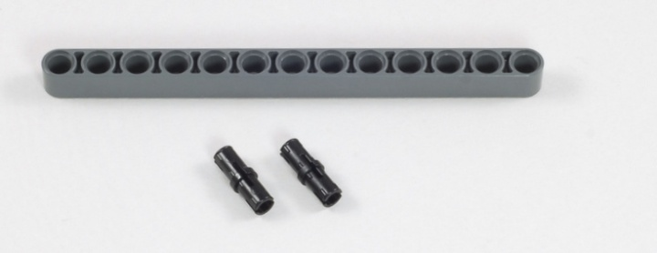
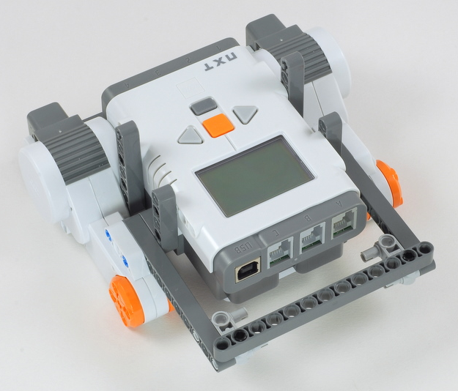
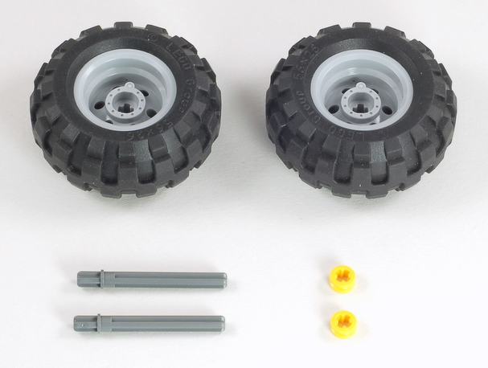
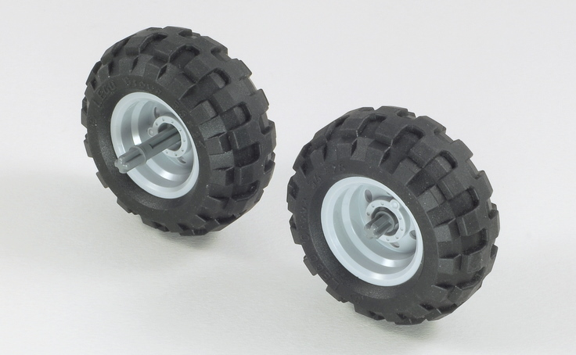
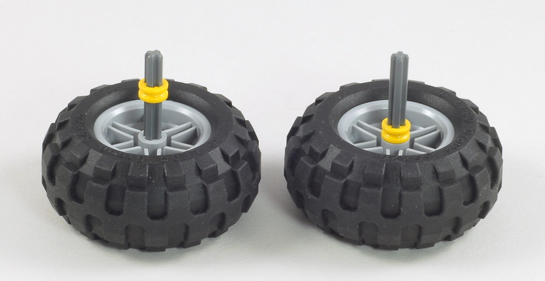
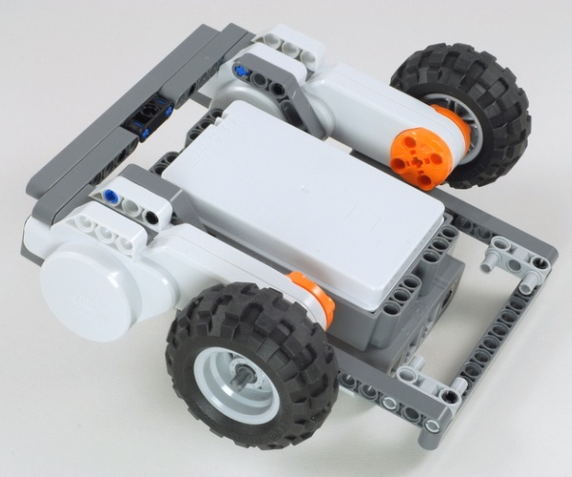
Express-Bot
Driving Base
Step-by-Step Instructions
4. Front Frame
13
5. Wheels
The Express-Bot design may be freely used and redistributed. Design by www.nxtprograms.com.

Slide 5
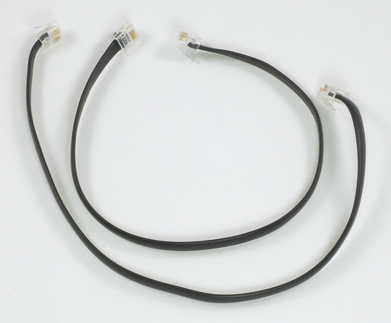
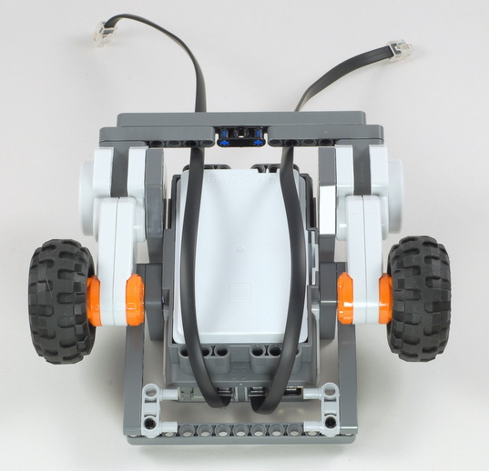
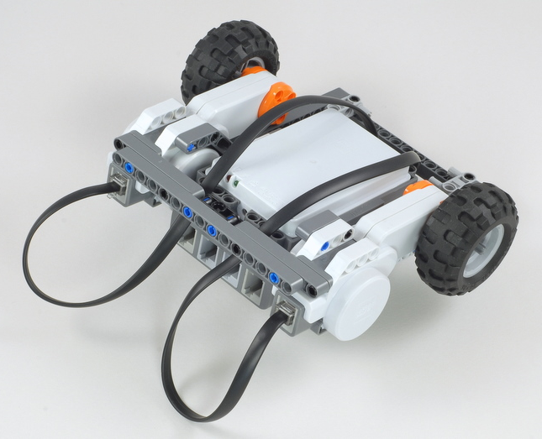
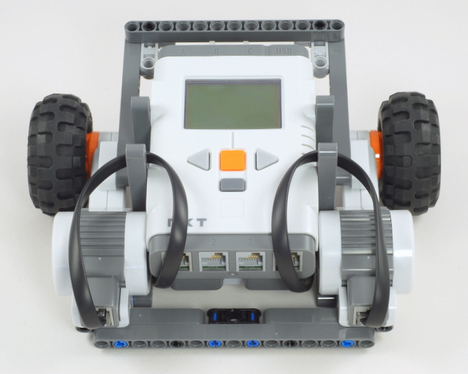
Express-Bot
Driving Base
Step-by-Step Instructions
6. Wires
35 cm (Medium)
2x
B C
The Express-Bot design may be freely used and redistributed. Design by www.nxtprograms.com.

Slide 6
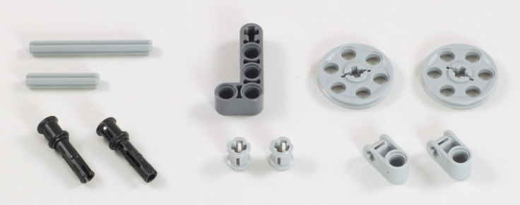
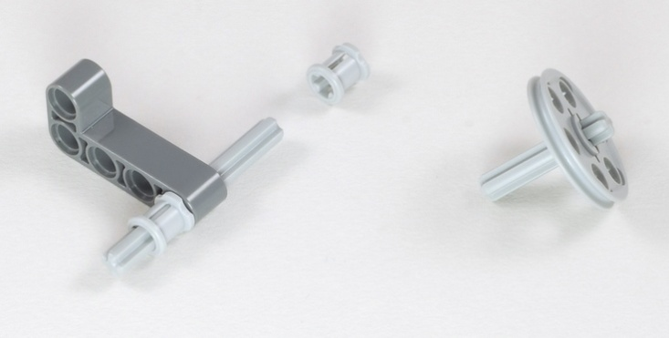
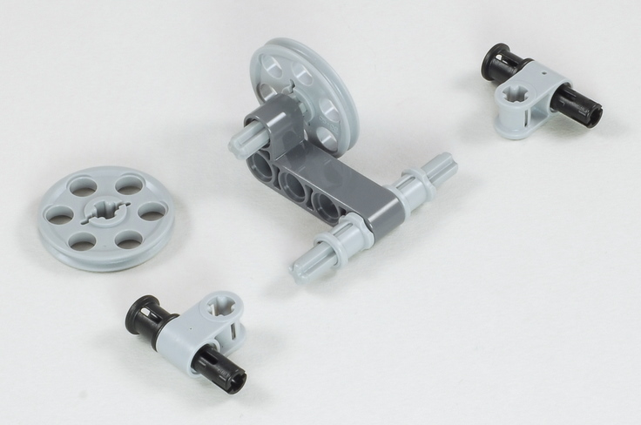
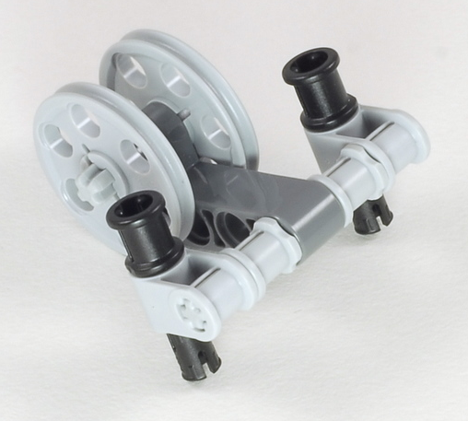
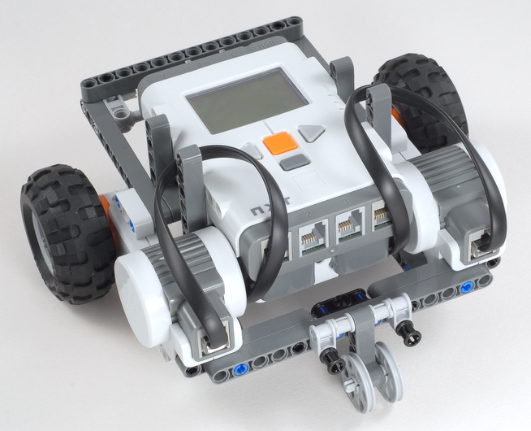
Express-Bot
Driving Base
Step-by-Step Instructions
7. Skid Wheel
5
3
3
5
The Express-Bot design may be freely used and redistributed. Design by www.nxtprograms.com.

