Slide 1
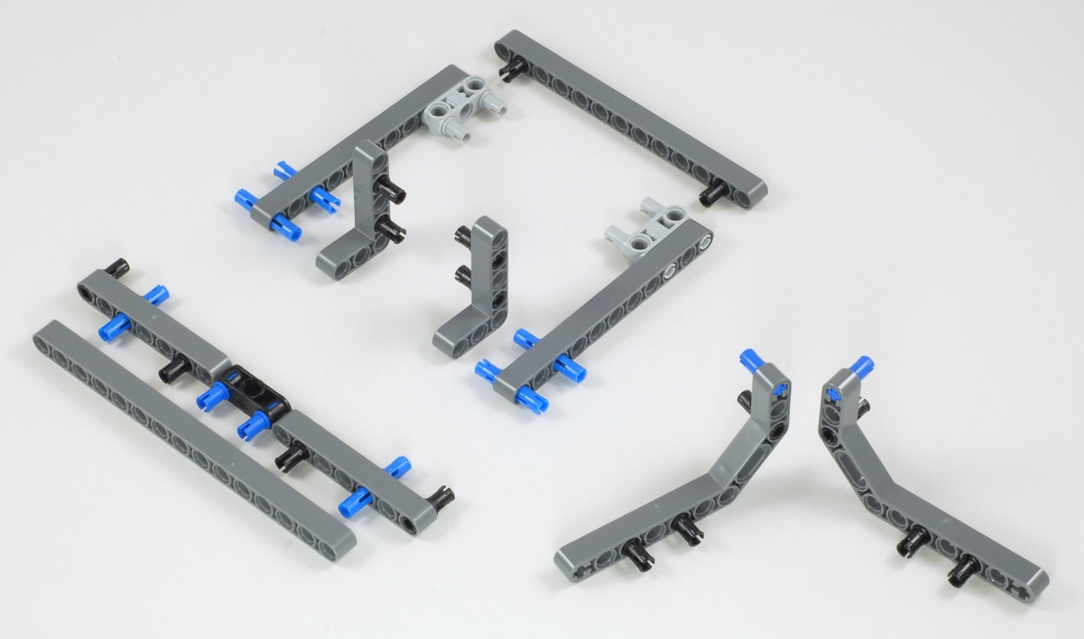
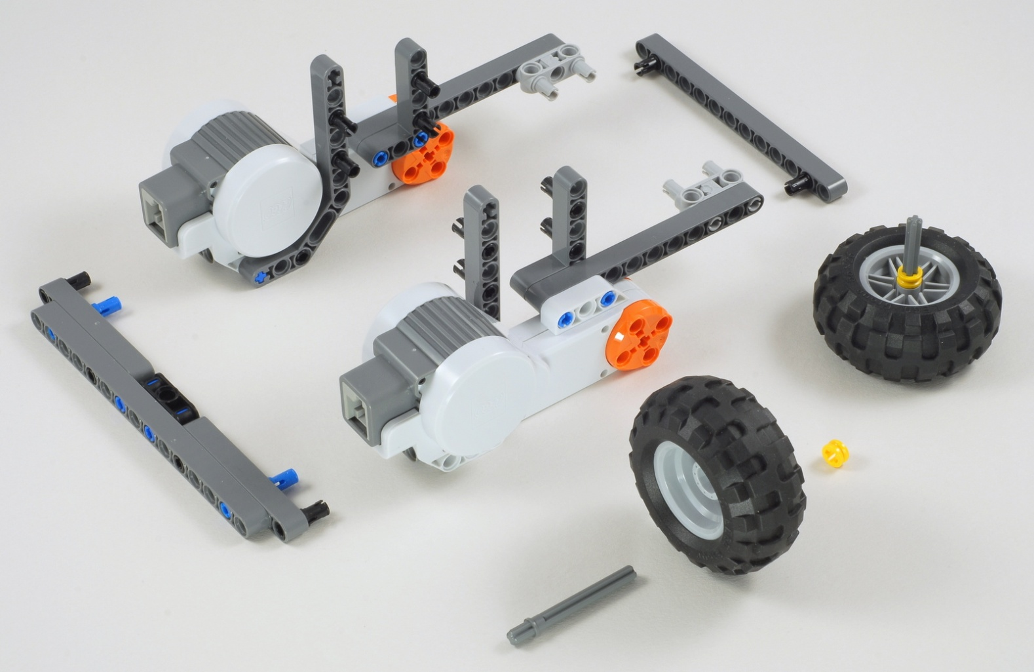
Express-Bot
Robot Base
Building Hints
1
11
13
7
11
7
15
2
The Express-Bot design may be freely used and redistributed. Design by www.nxtprograms.com.

Slide 2
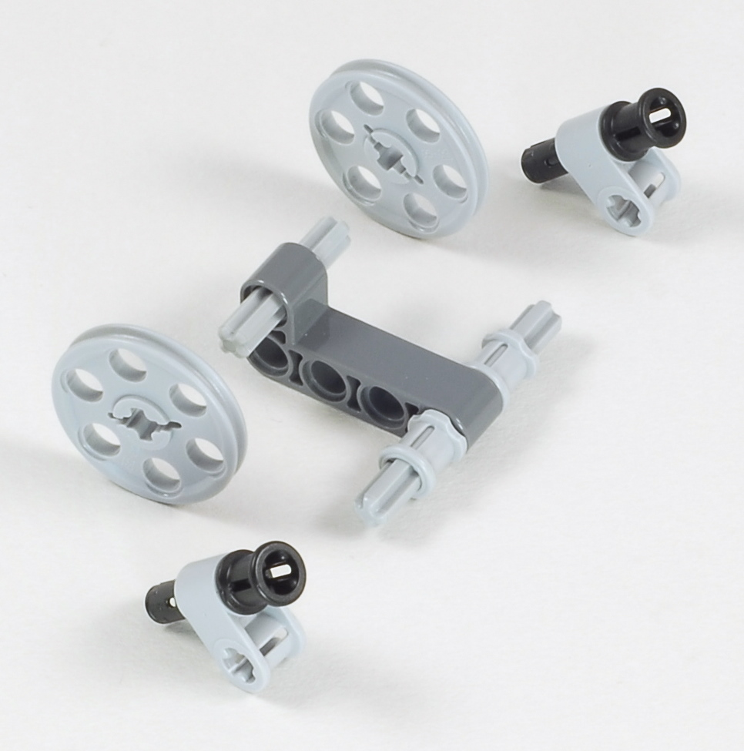
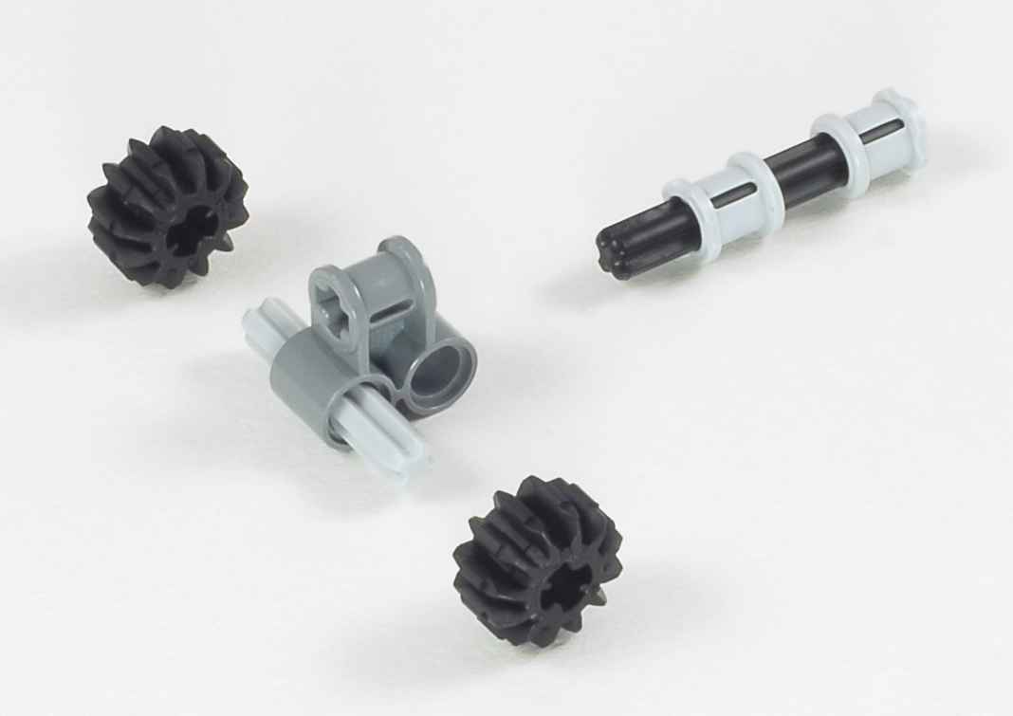
Express-Bot
Balance Wheels
Building Hints
3
5
Skid Wheel
4
3
Castor Wheel
The Express-Bot design may be freely used and redistributed. Design by www.nxtprograms.com.

Slide 3
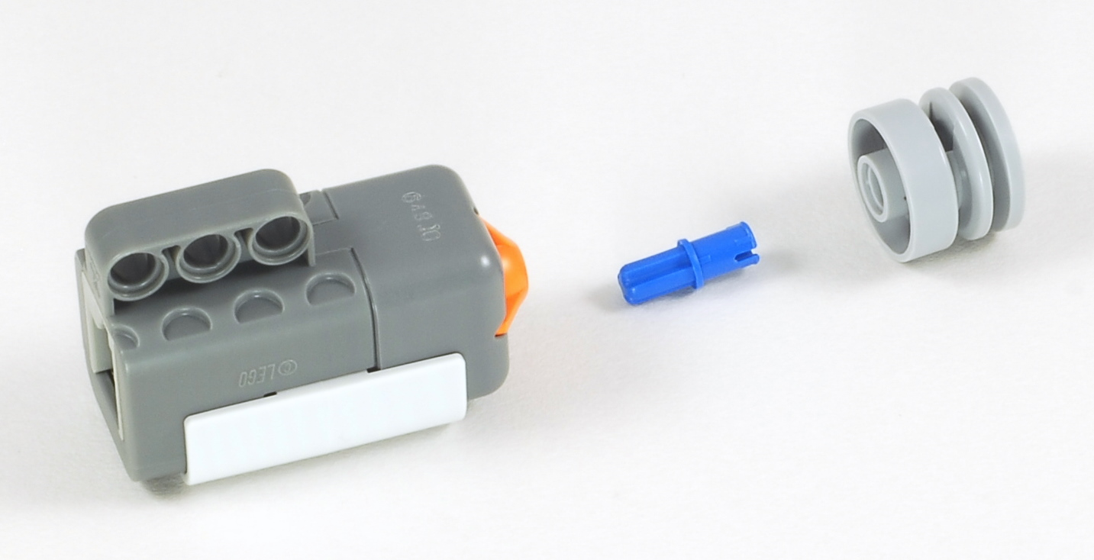
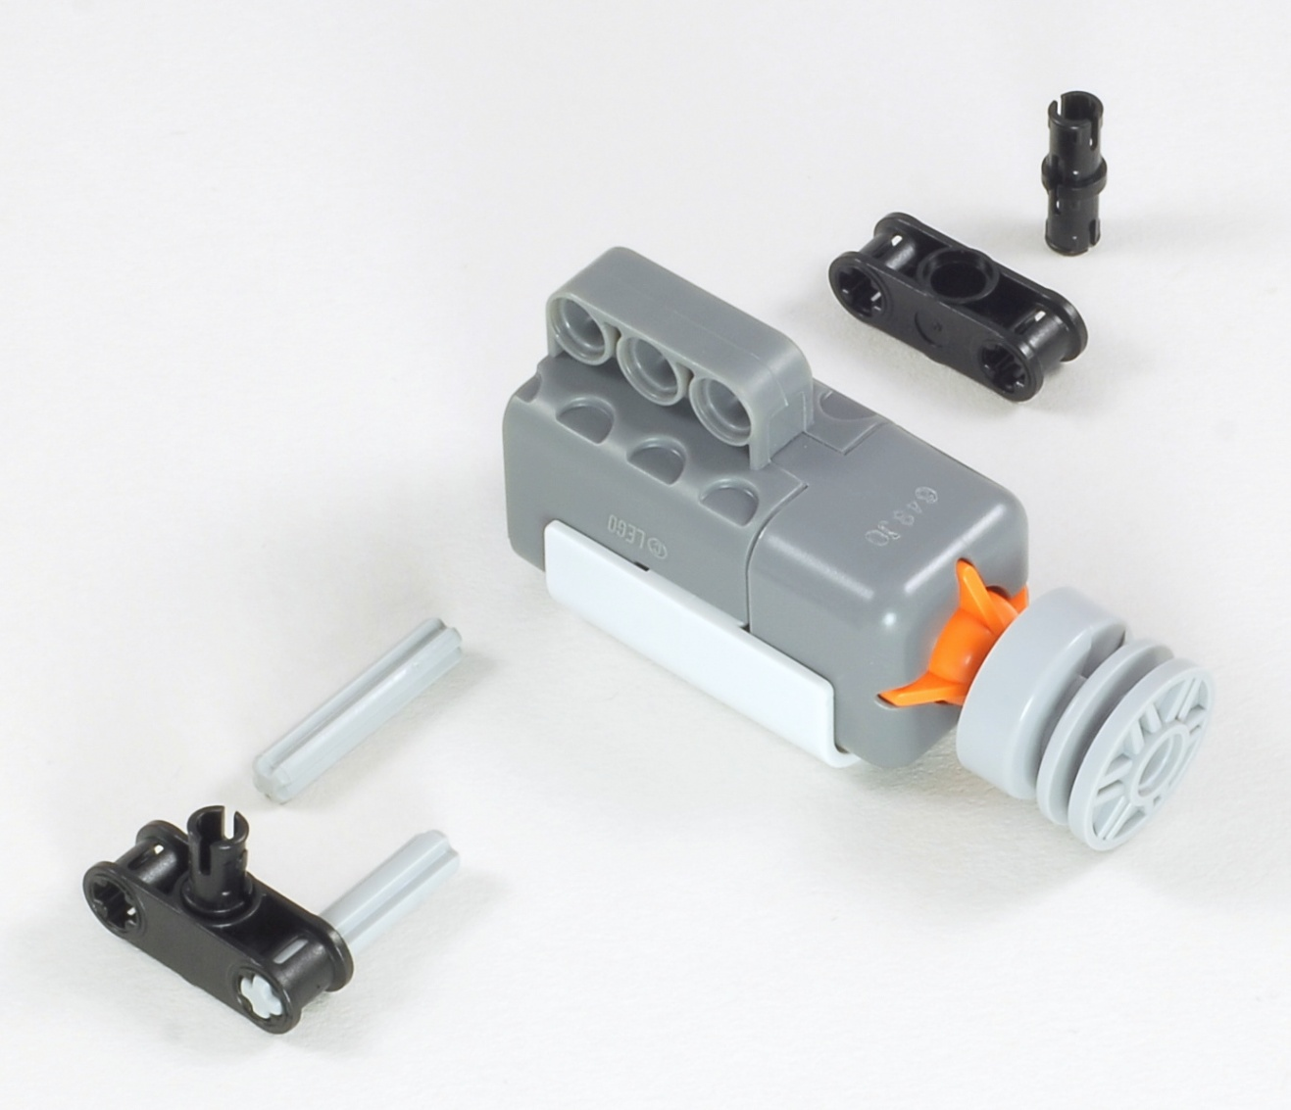
Express-Bot
Touch Sensor
Building Hints
Front/Side
Front/Center
3
3
The Express-Bot design may be freely used and redistributed. Design by www.nxtprograms.com.

Slide 4
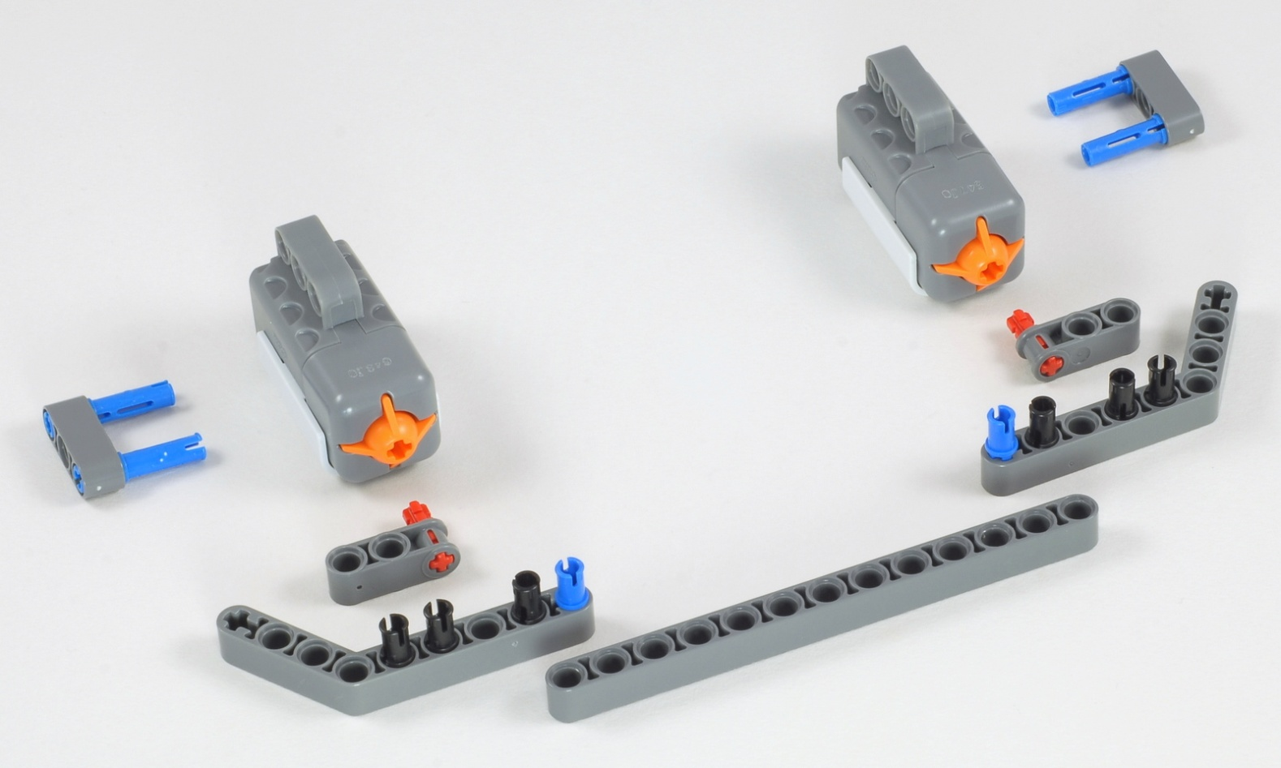
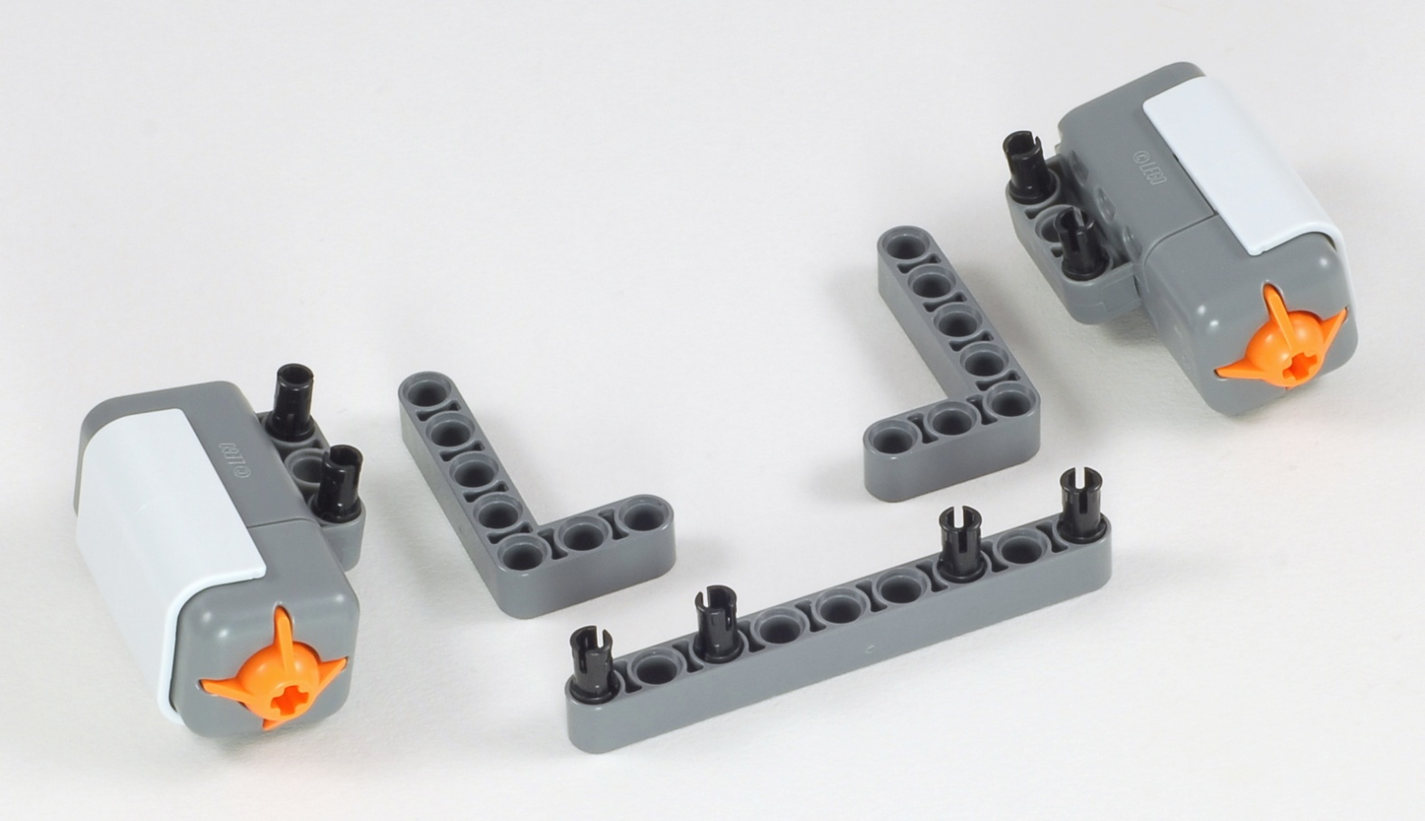
Express-Bot
Double Touch Sensor
Building Hints
Double Touch Sensor Bumper
13
Two-Button Remote Control
9
The Express-Bot design may be freely used and redistributed. Design by www.nxtprograms.com.

Slide 5
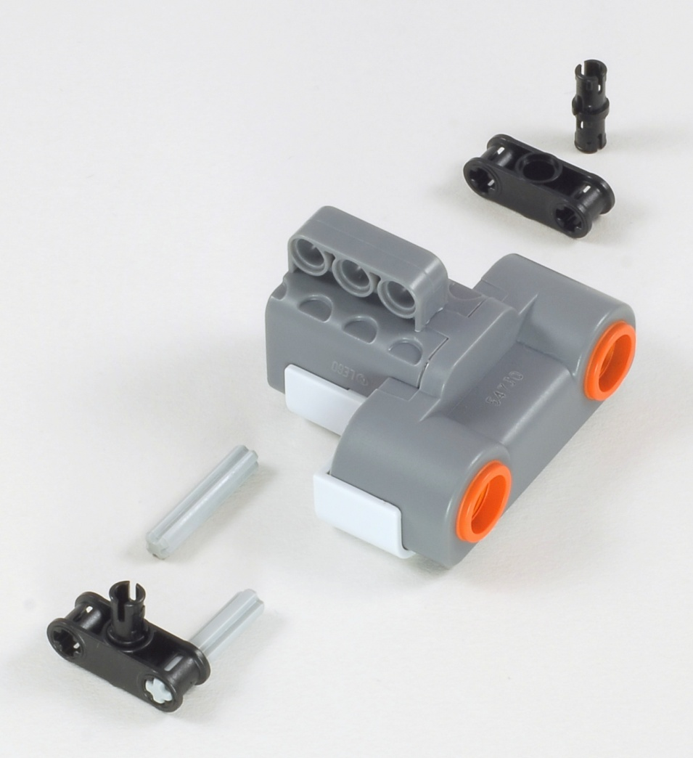
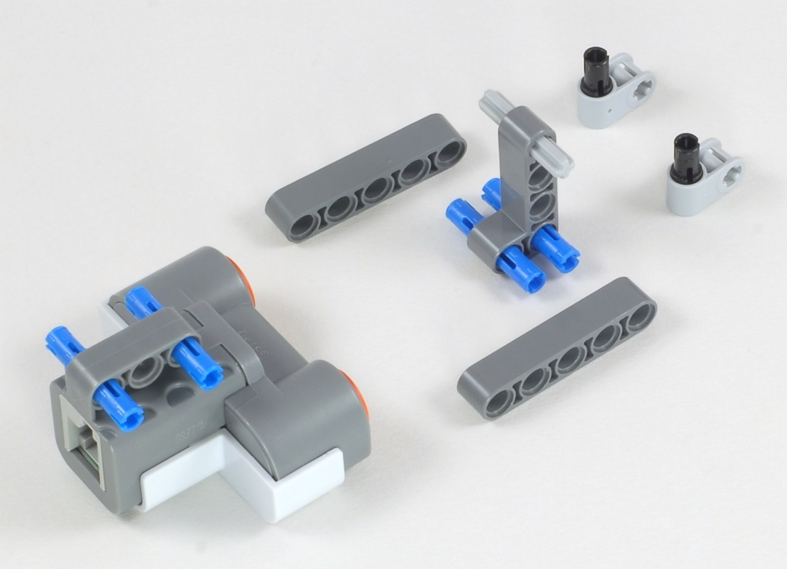
Express-Bot
Ultrasonic Sensor
Building Hints
Low/Center
Middle
3
3
High
3
The Express-Bot design may be freely used and redistributed. Design by www.nxtprograms.com.

Slide 6
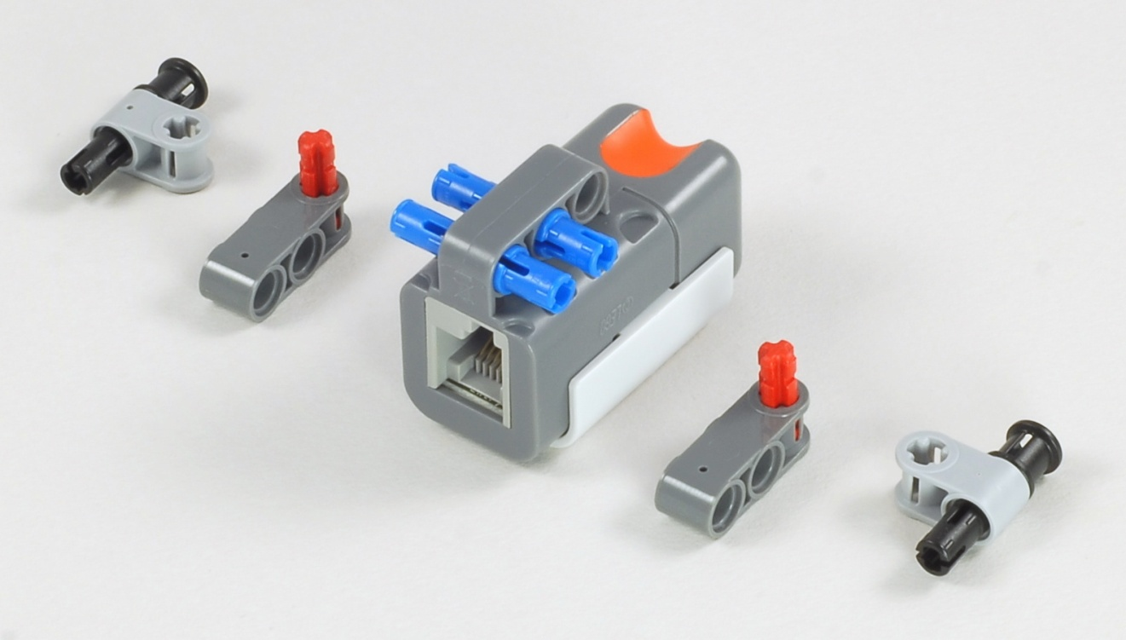
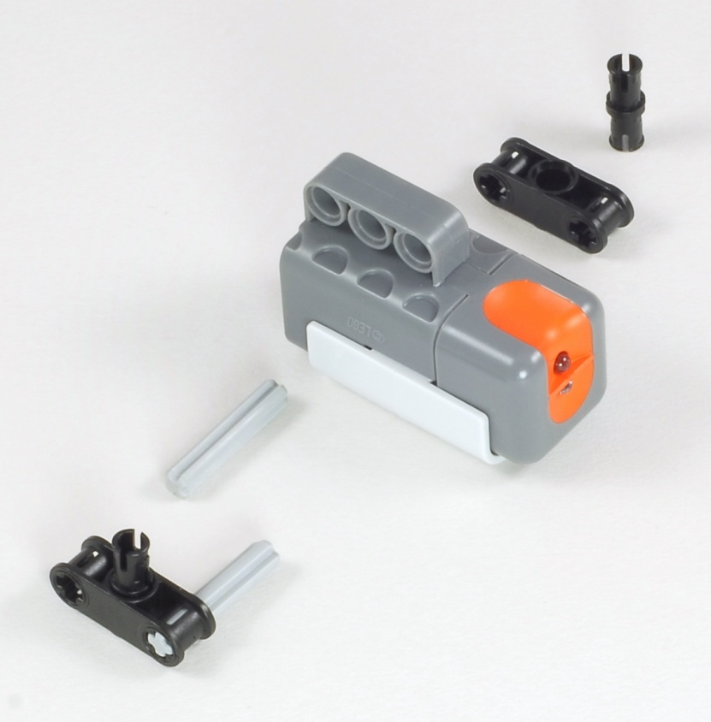
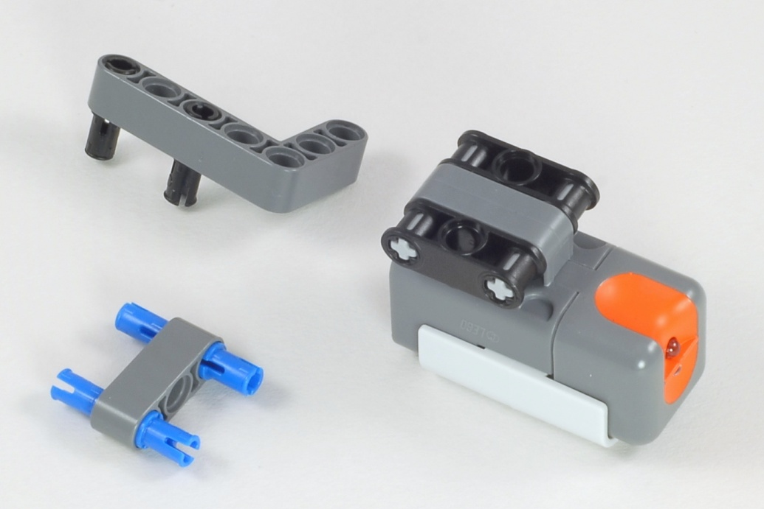
Express-Bot
Light Sensor
Building Hints
Downward
Center
3
3
Sideways
The Express-Bot design may be freely used and redistributed. Design by www.nxtprograms.com.

Slide 7
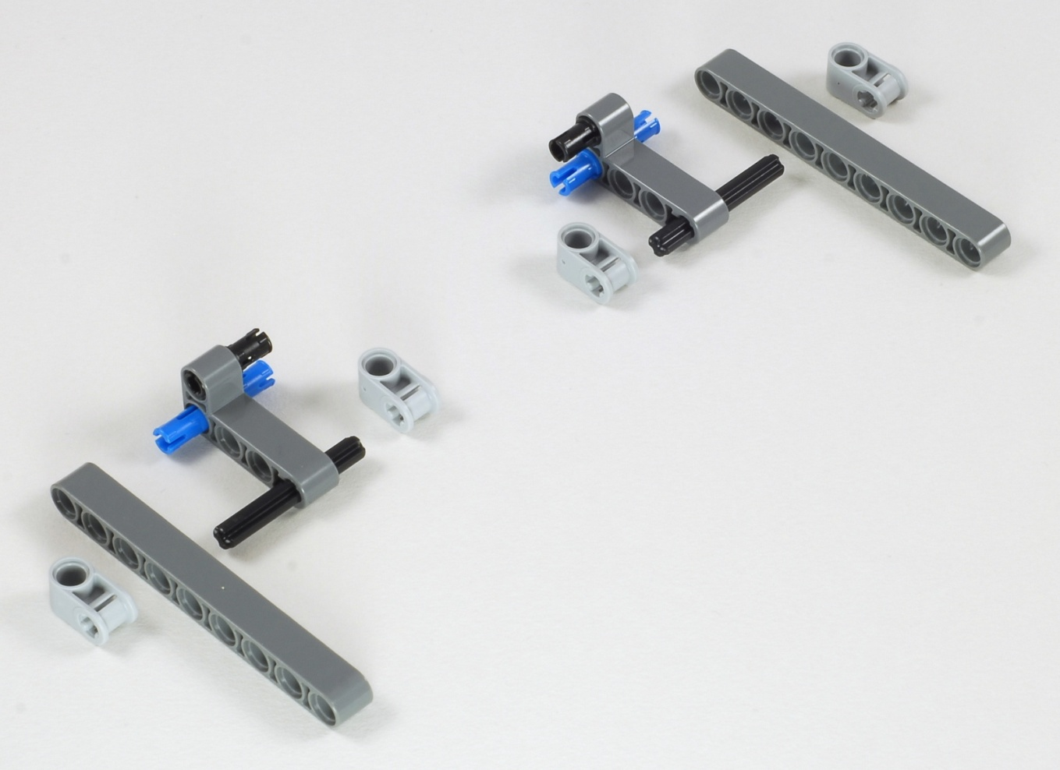
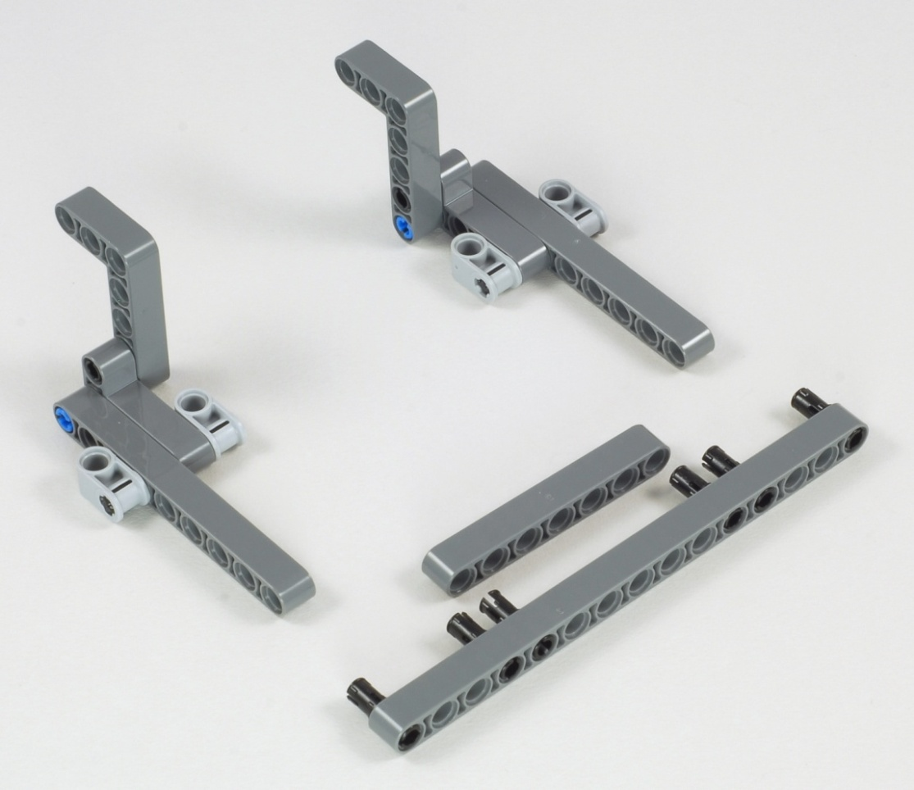
Express-Bot
Pusher
Building Hints
1
9
4
4
9
2
7
15
The Express-Bot design may be freely used and redistributed. Design by www.nxtprograms.com.

Slide 8
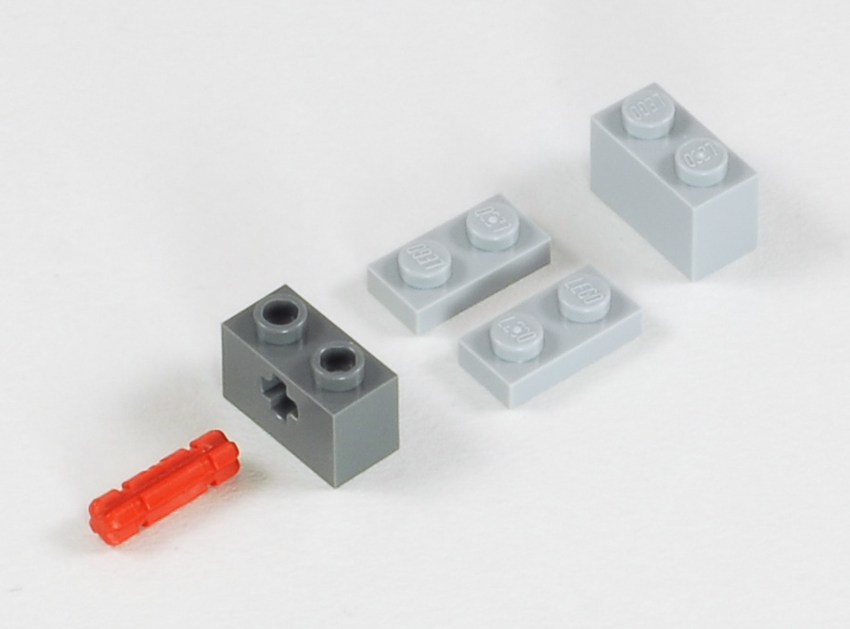
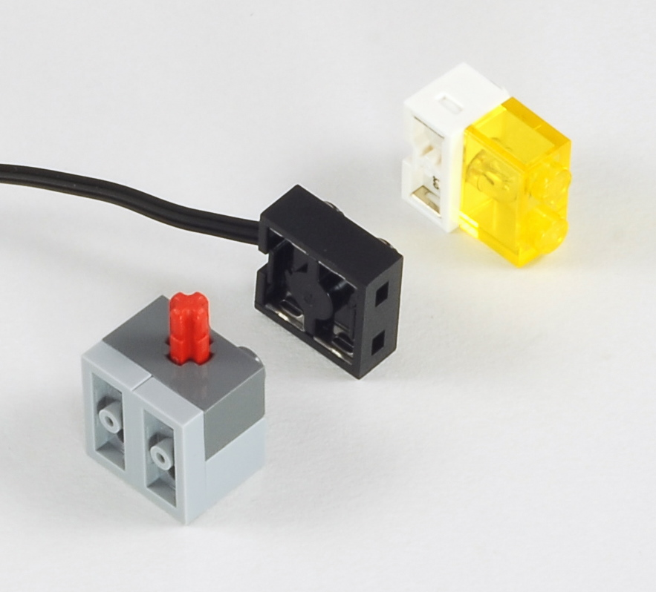
Express-Bot
Lamp
Building Hints
1
2
The Express-Bot design may be freely used and redistributed. Design by www.nxtprograms.com.

Slide 9
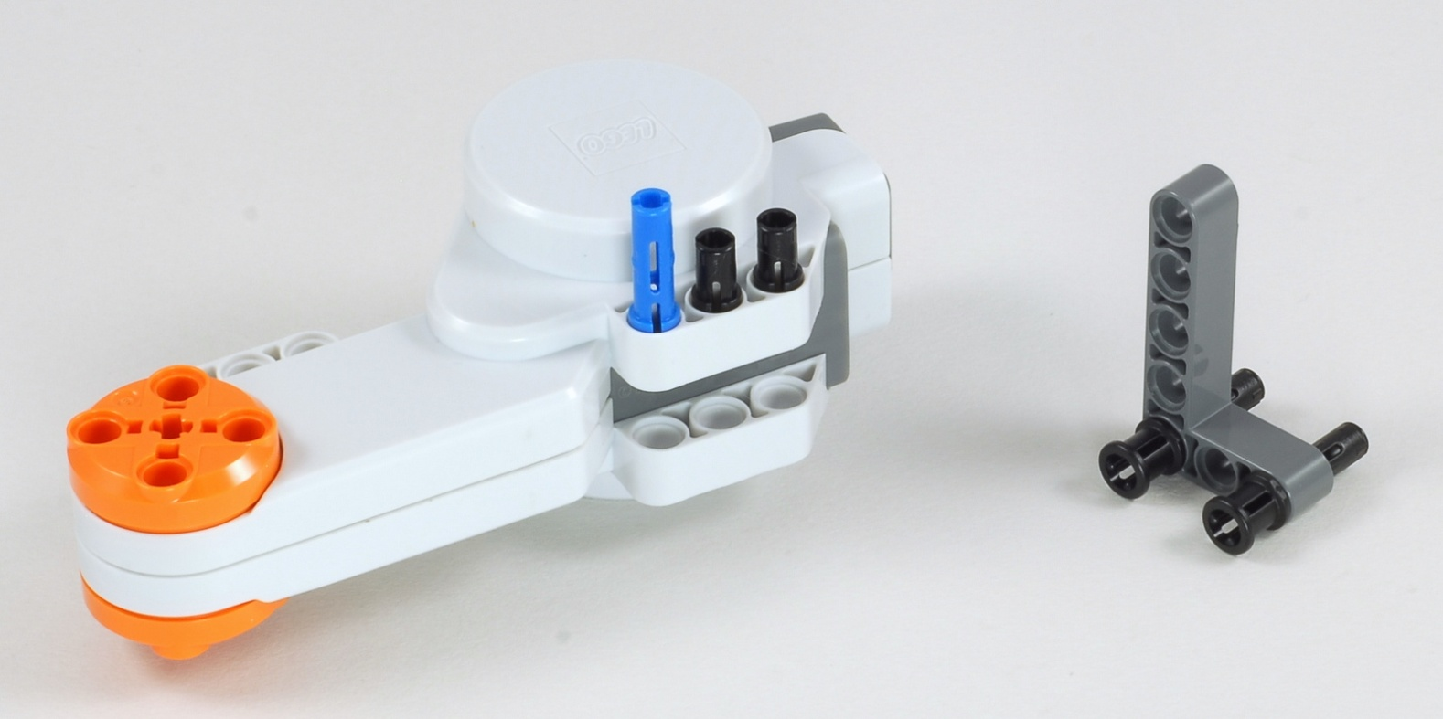
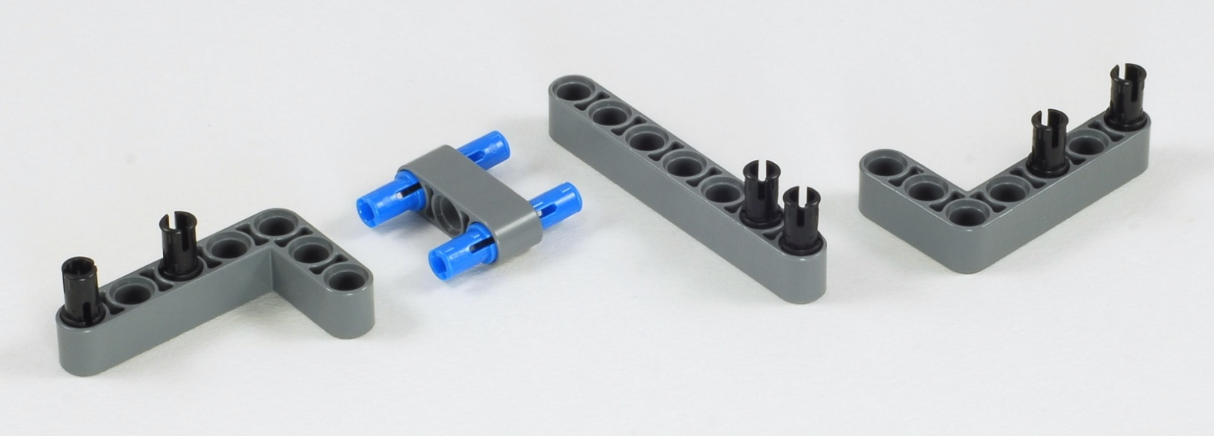
Express-Bot
Vertical Motor
Building Hints
Optional Motor Brace
7
The Express-Bot design may be freely used and redistributed. Design by www.nxtprograms.com.

Slide 10
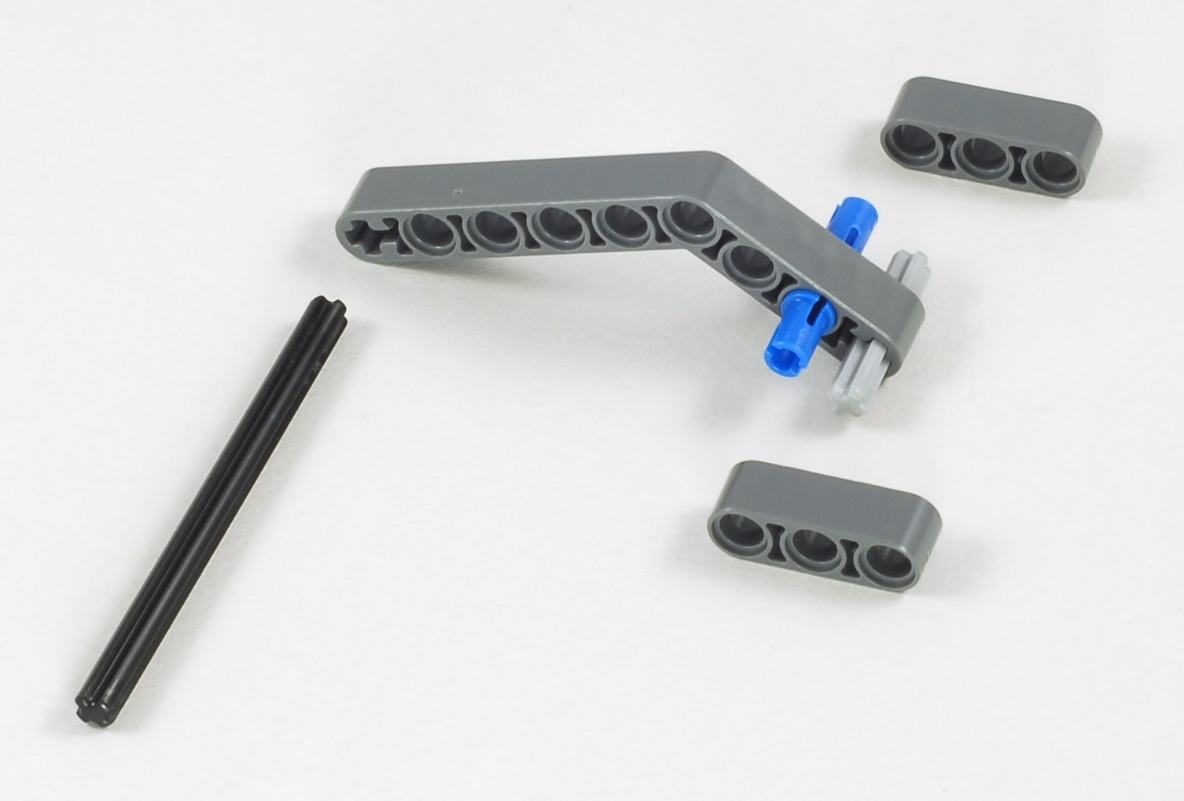
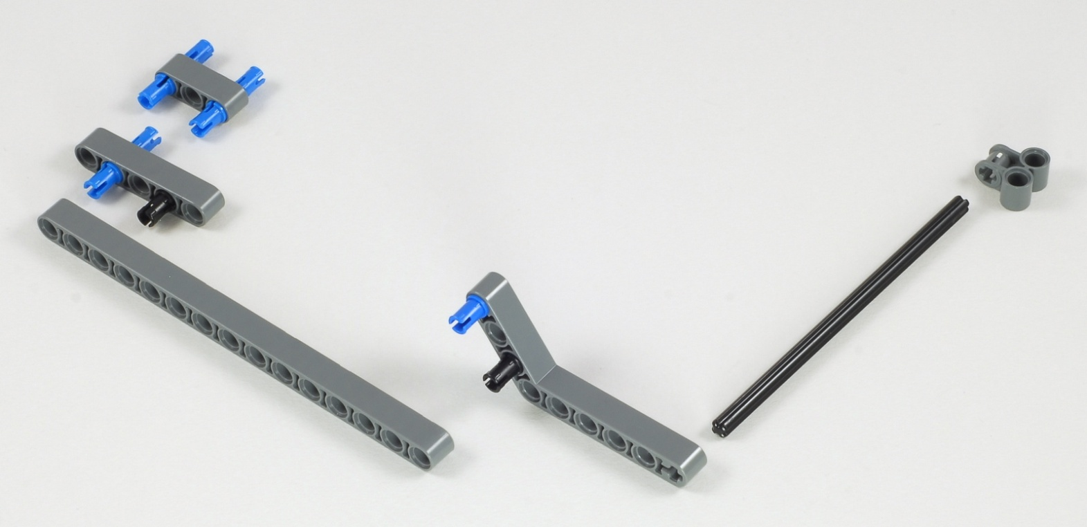
Express-Bot
Kicker and Long Arm
Building Hints
Kicker
3
8
Long Arm
12
15
The Express-Bot design may be freely used and redistributed. Design by www.nxtprograms.com.

Slide 11
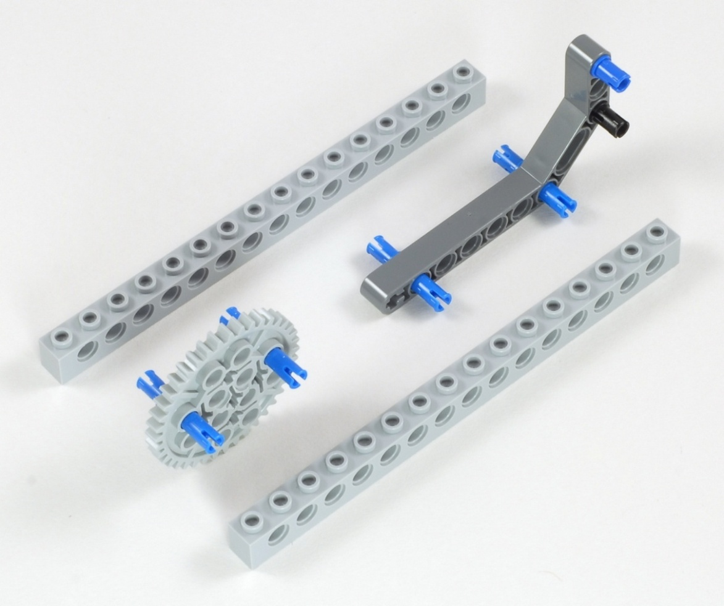
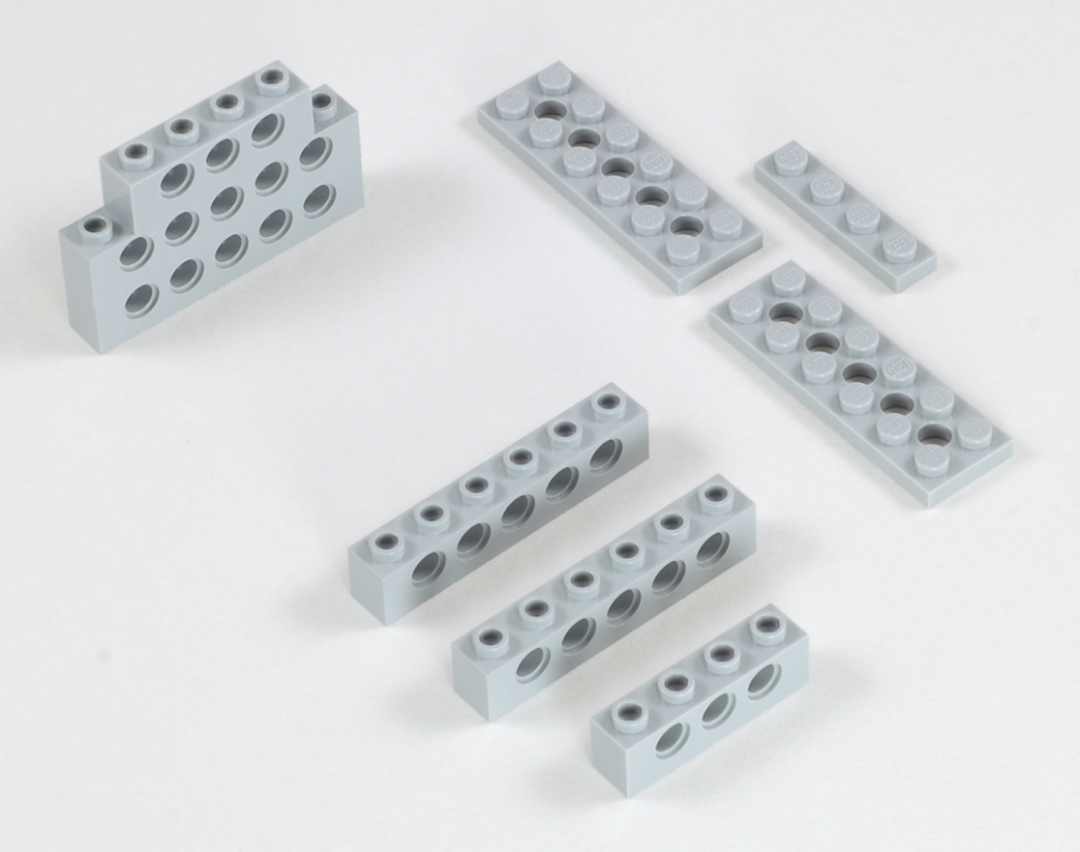
Express-Bot
Karate Arm and Chopping Block
Building Hints
Karate Arm
Chopping Block
The Express-Bot design may be freely used and redistributed. Design by www.nxtprograms.com.

Slide 12
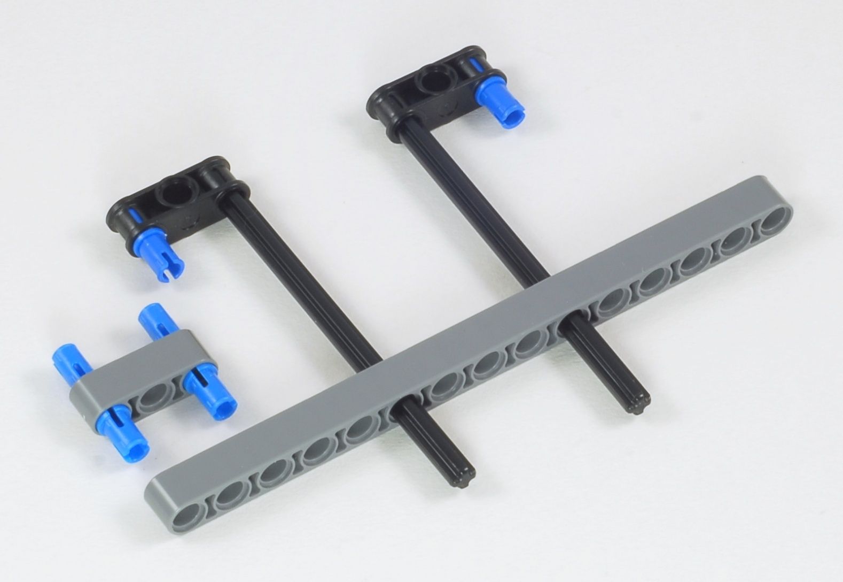
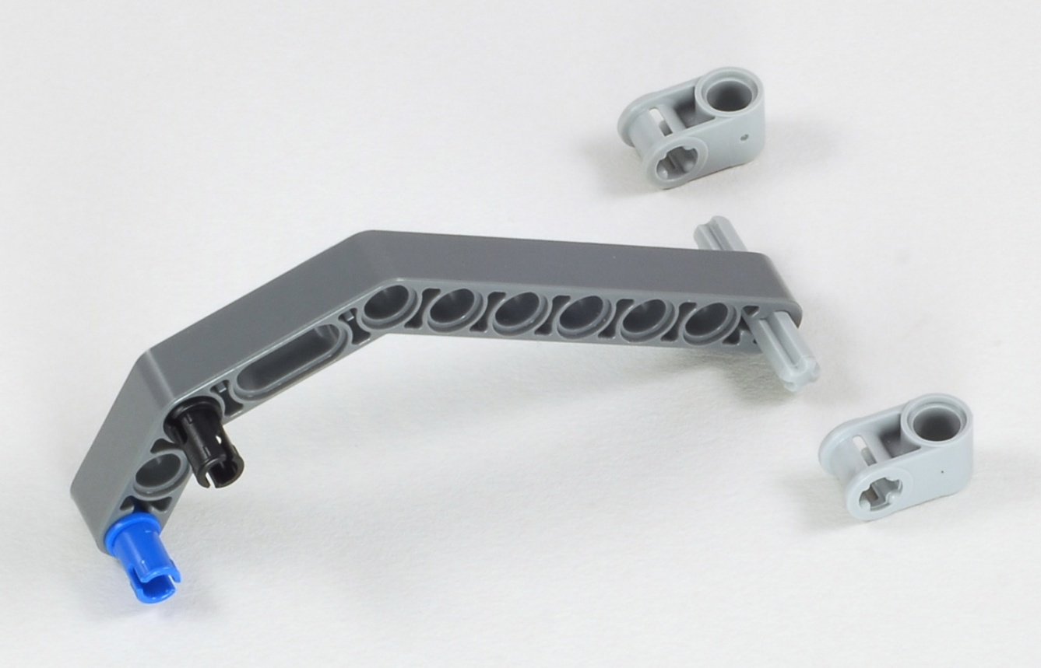
Express-Bot
Forklift Arm
Building Hints
1
15
10
10
2
3
The Express-Bot design may be freely used and redistributed. Design by www.nxtprograms.com.

Slide 13
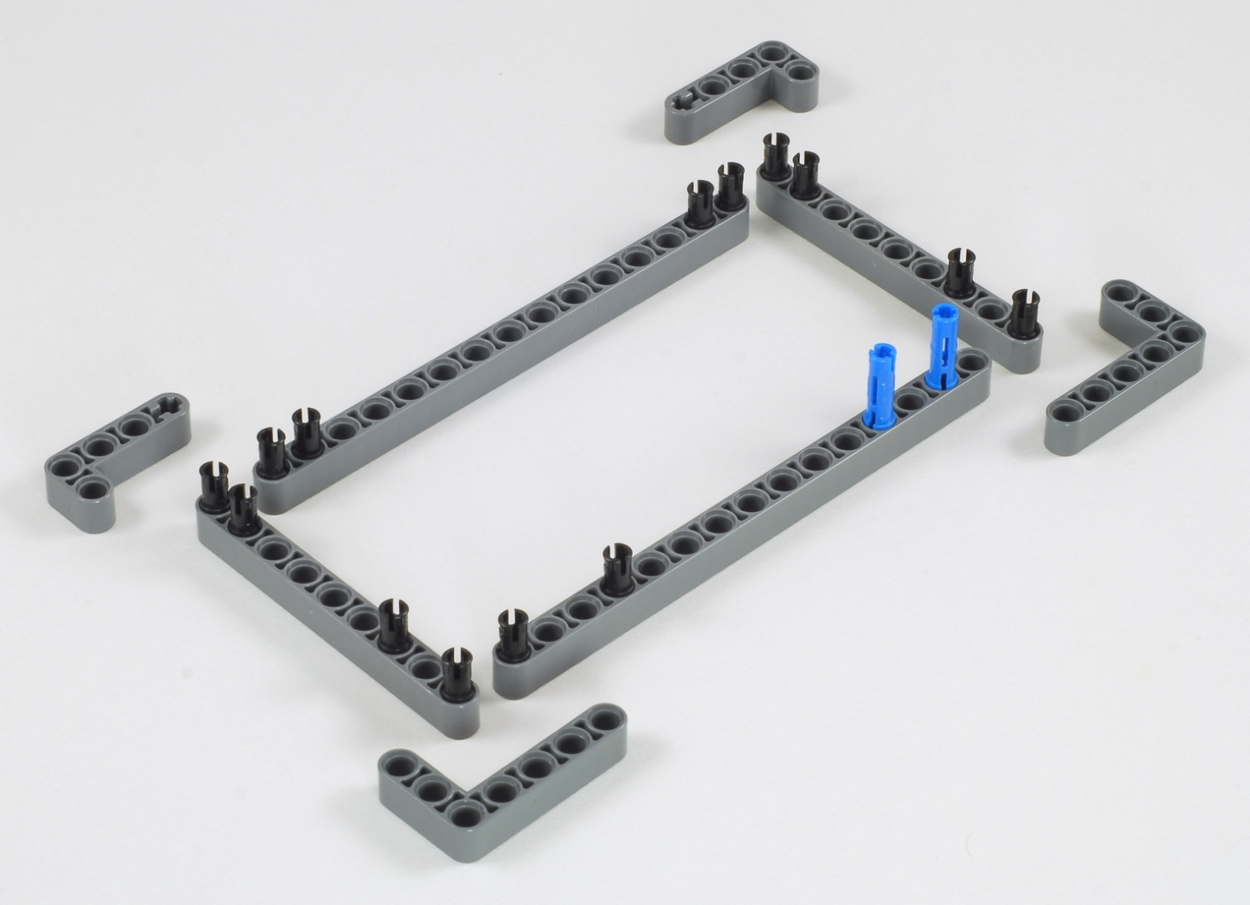
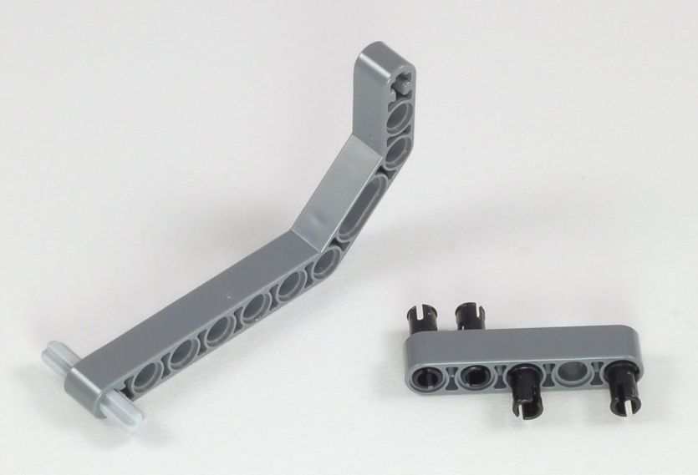
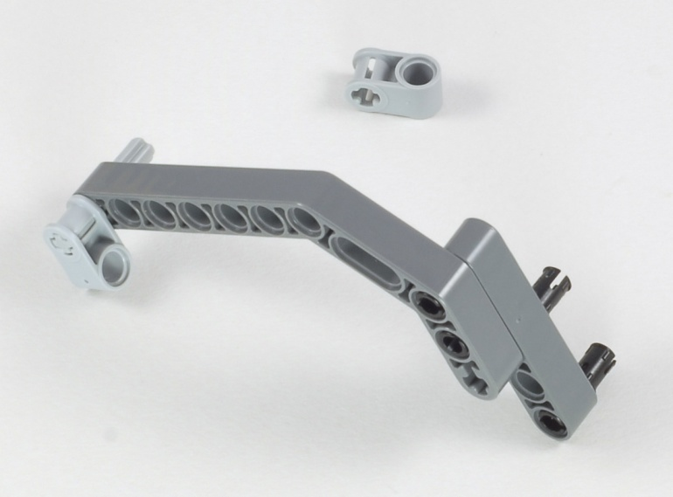
Express-Bot
Box Trap
Building Hints
1
9
15
15
9
2
3
3
The Express-Bot design may be freely used and redistributed. Design by www.nxtprograms.com.

Slide 14
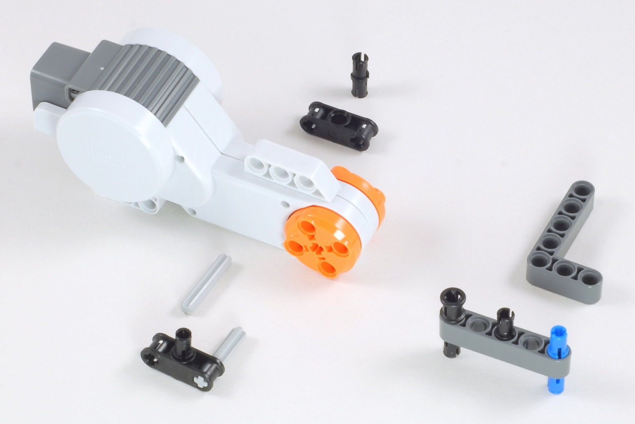
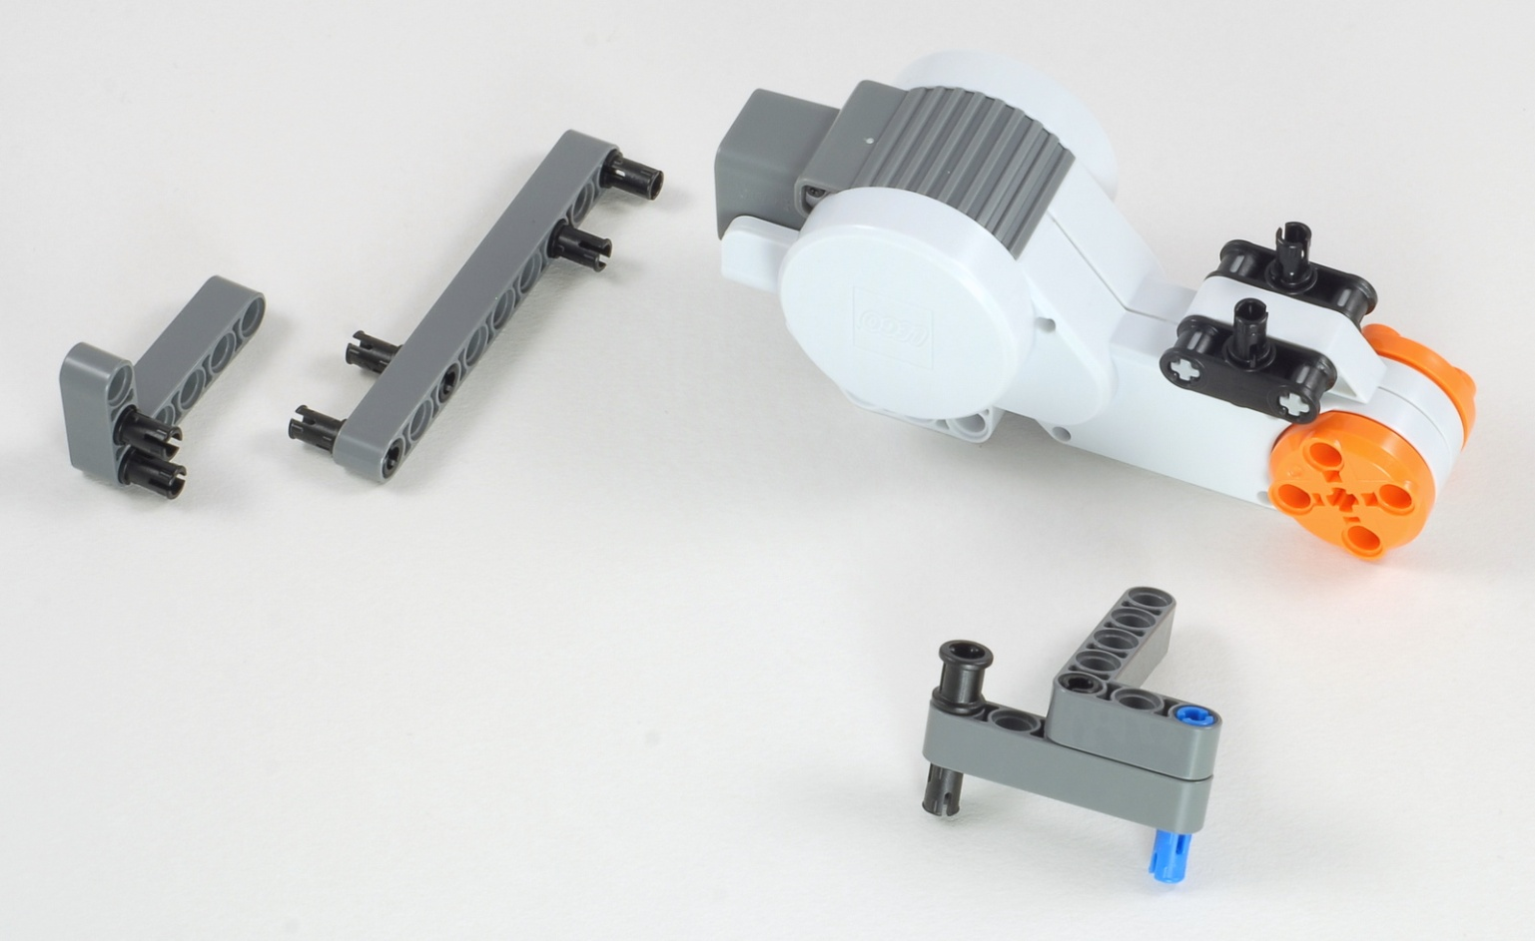
Express-Bot
Horizontal Motor
Building Hints
1
3
3
2
9
The Express-Bot design may be freely used and redistributed. Design by www.nxtprograms.com.

Slide 15
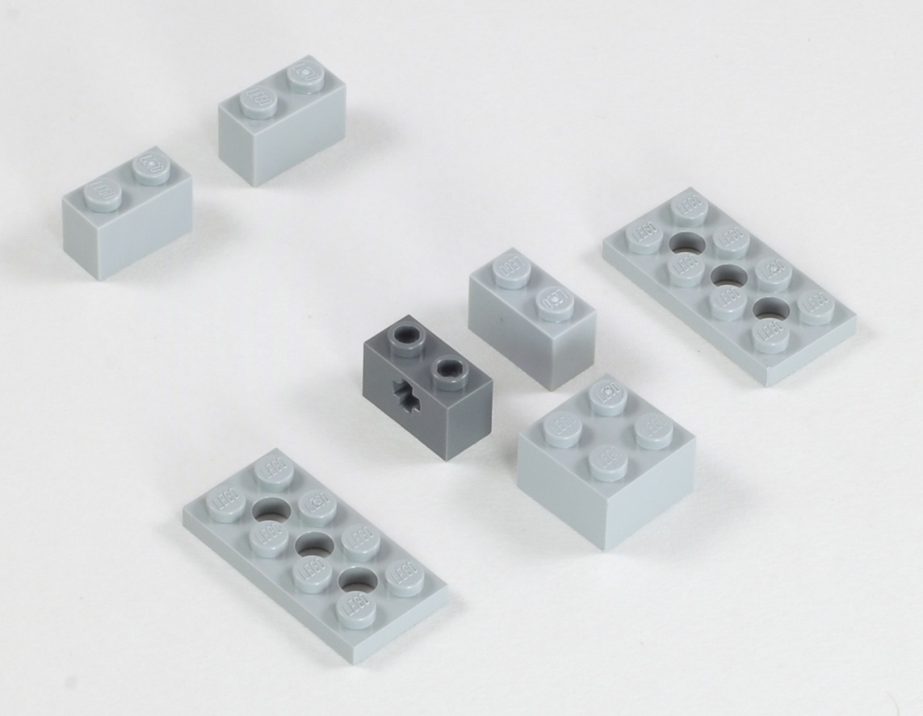
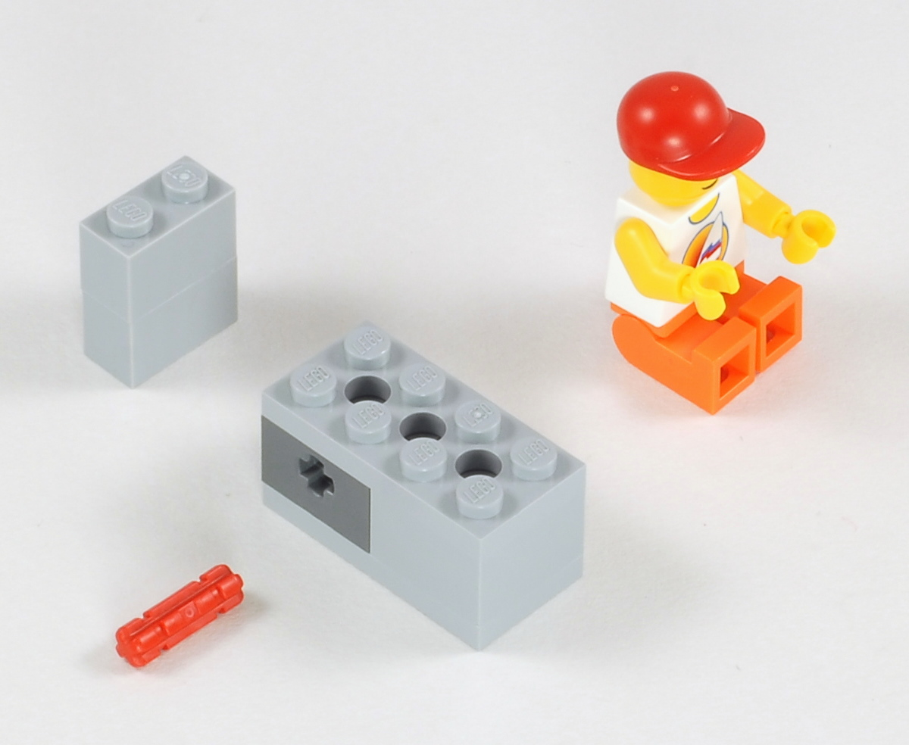
Express-Bot
Driver
Building Hints
1
2
The Express-Bot design may be freely used and redistributed. Design by www.nxtprograms.com.

Slide 16
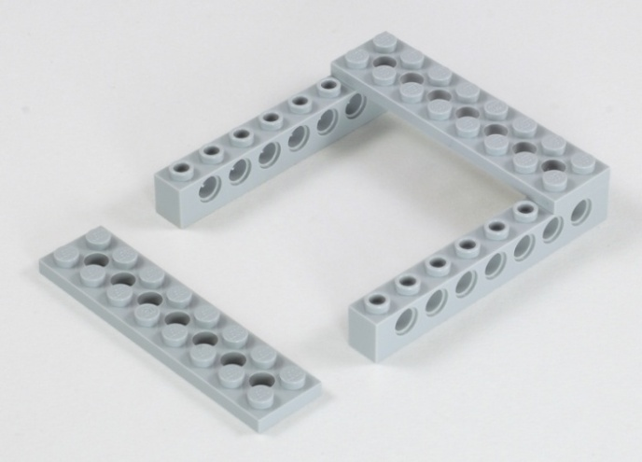
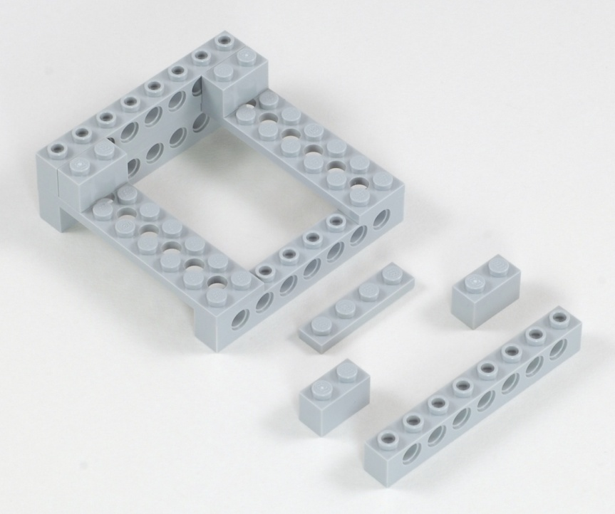
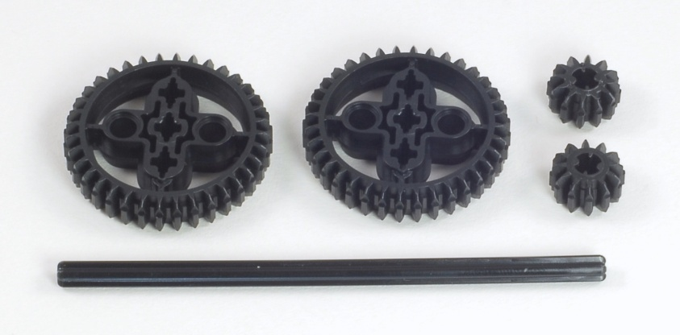
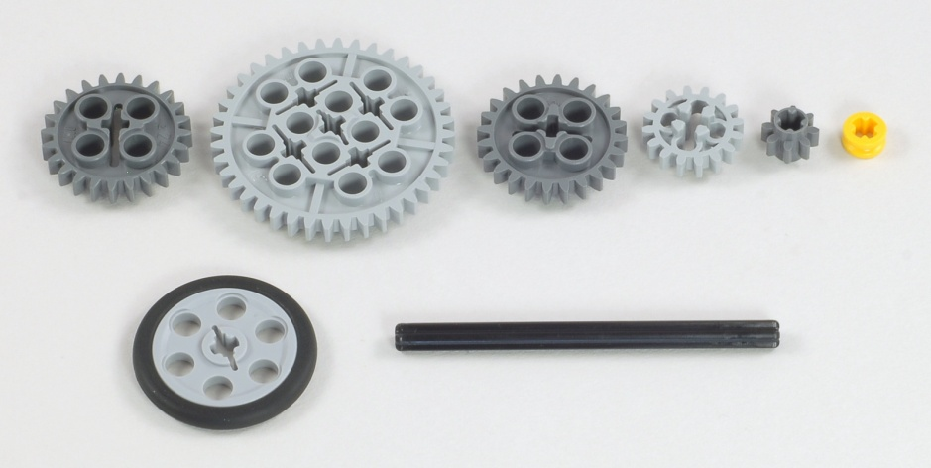
Express-Bot
Forklift Objects
Building Hints
1
2
Ball Pallet
Barbell
12
Tree
8
The Express-Bot design may be freely used and redistributed. Design by www.nxtprograms.com.

Slide 17
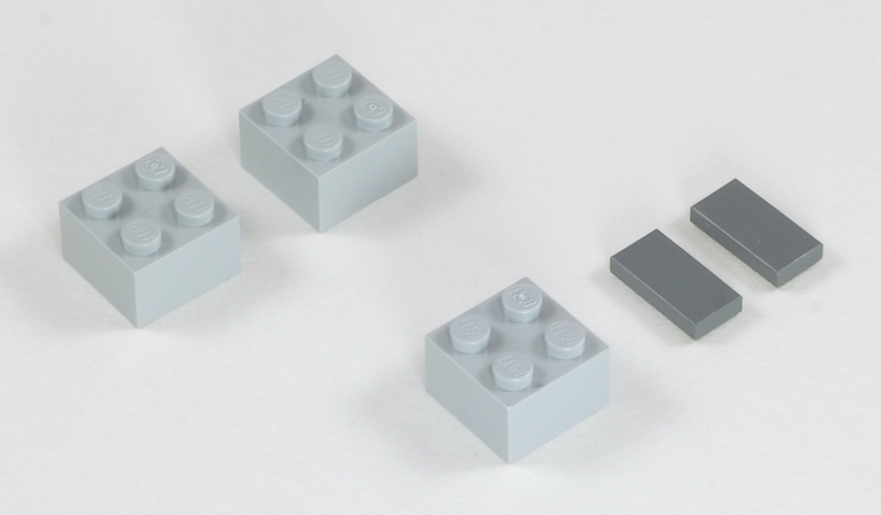
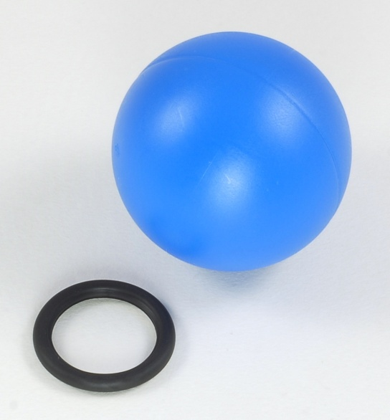
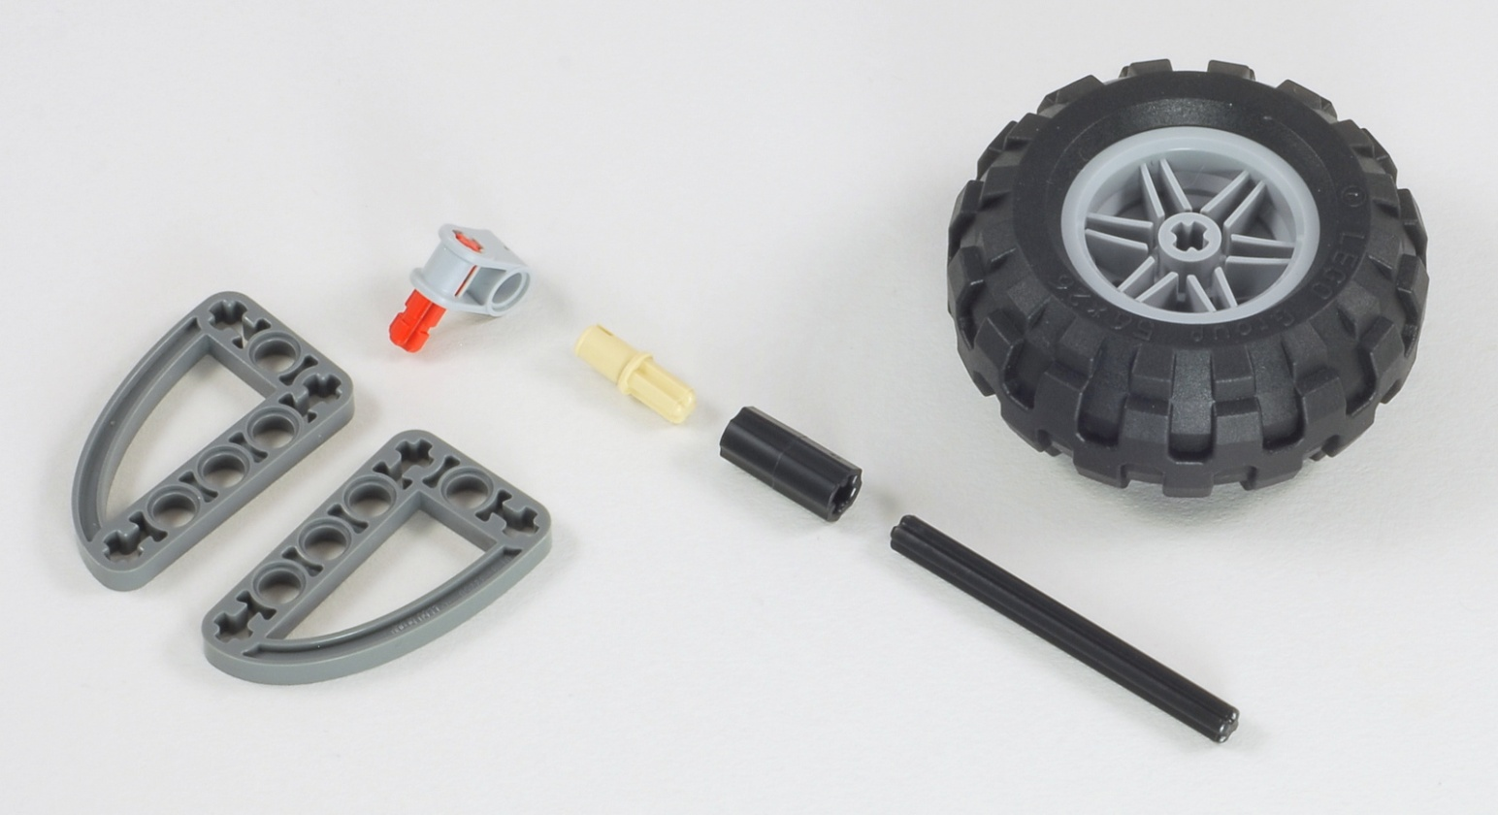
Express-Bot
Game Objects
Building Hints
Boxes
Ball Stand
Pivoting Flag
6
The Express-Bot design may be freely used and redistributed. Design by www.nxtprograms.com.

