Slide 1
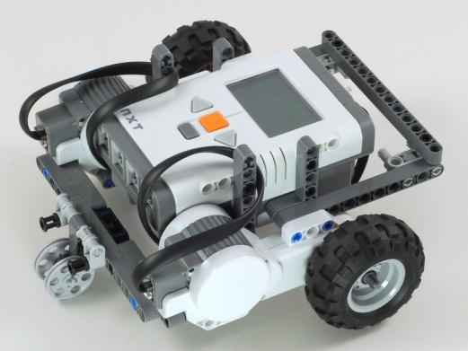
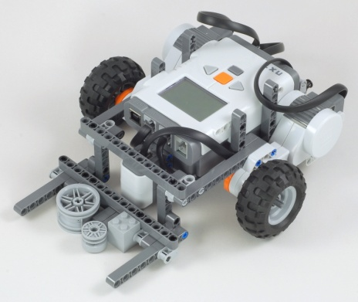
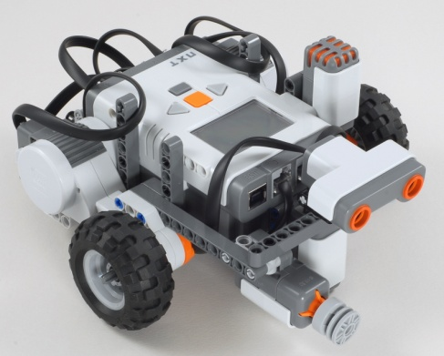
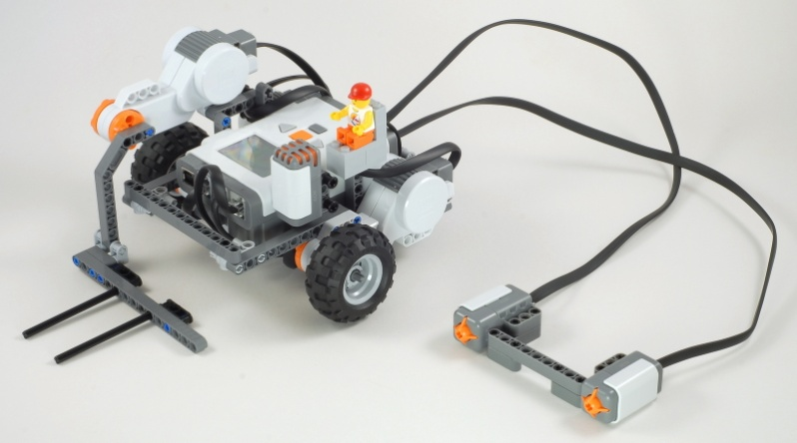
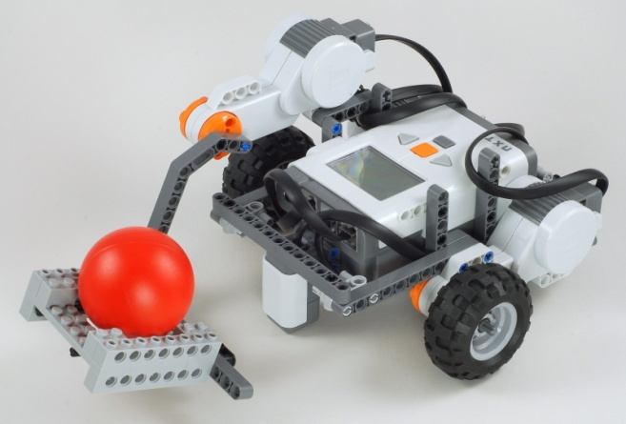
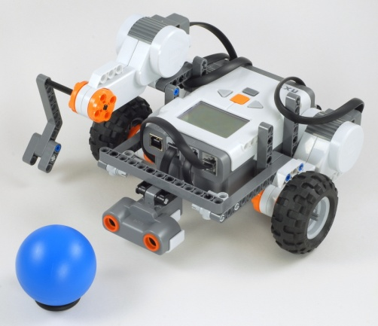
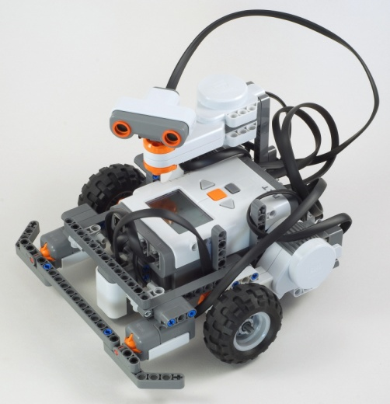
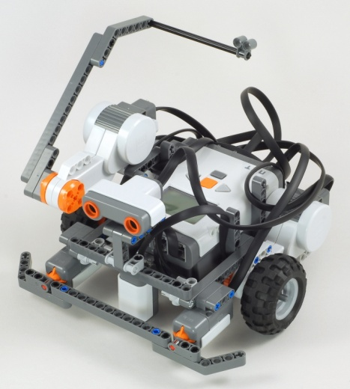
Express-Bot is designed for use with the LEGO® MINDSTORMS ® Education NXT Base Set (9797), requiring no extra parts.
Express-Bot
Selected Attachment
Combination Ideas
Driving Base
Robot Base + Balance Wheel
Line Sensing Pusher
Driving Base + Pusher +
Light Sensor
4-Sensor Test Bot
Driving Base + Touch Sensor + Light Sensor + Sound Sensor + Ultrasonic Sensor
Remote Controlled Forklift
Robot Base + Vertical Motor + Forklift Arm + Driver + Sound Sensor + Two Button Remote Control
Line Following Forklift
Robot Base + Forklift Arm + Light Sensor
Ultrasonic Ball Kicker
Driving Base + Vertical Motor + Kicker + Ultrasonic Sensor
Pivoting Head Explorer
Driving Base + Horizontal Motor + Ultrasonic Sensor + Light Sensor +
Double Touch Sensor Bumper
Robot Tag
Driving Base + Vertical Motor + Long Arm + Ultrasonic Sensor + Double Touch Sensor Bumper + Light Sensor
The Express-Bot design may be freely used and redistributed. Design by www.nxtprograms.com.

Slide 2
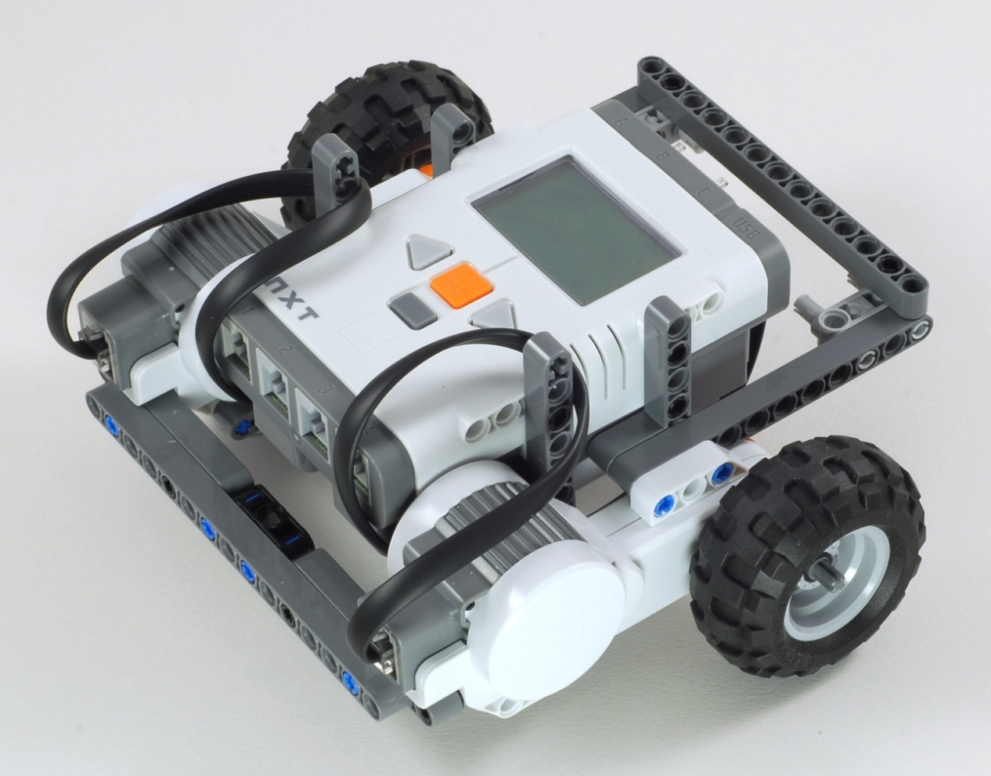
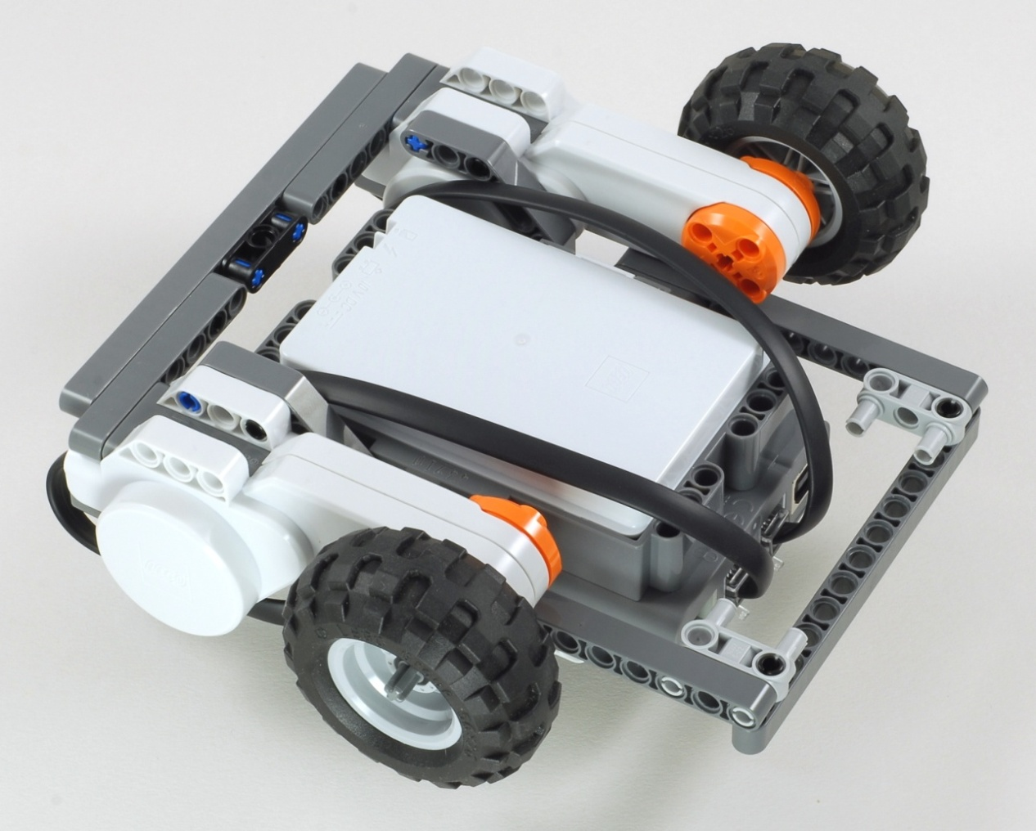
Express-Bot
Robot Base
Add a Balance Wheel to make a complete robot.
The Express-Bot design may be freely used and redistributed. Design by www.nxtprograms.com.

Slide 3
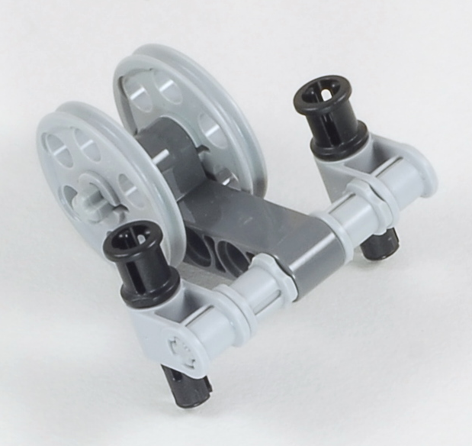
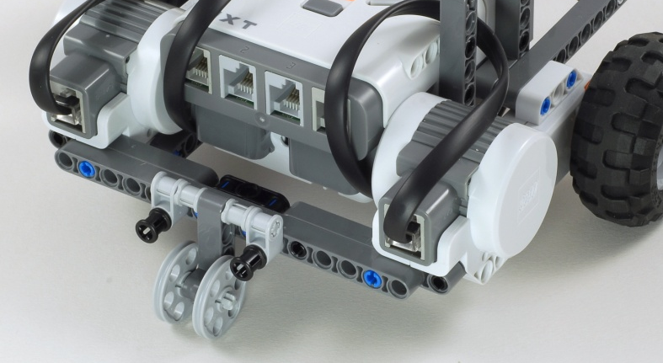
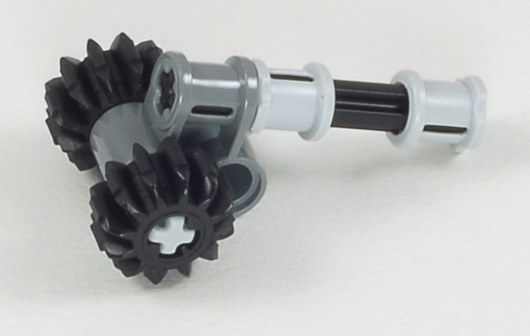
Express-Bot
Balance Wheels
Choose either the Skid Wheel or the Castor Wheel, depending on your surface.
Skid Wheel for smooth surfaces
Castor Wheel for carpet or rough surfaces
The Express-Bot design may be freely used and redistributed. Design by www.nxtprograms.com.

Slide 4
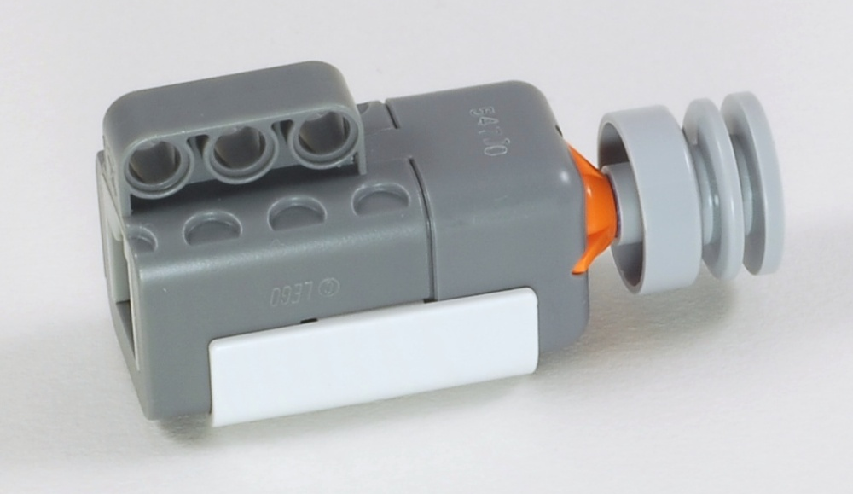
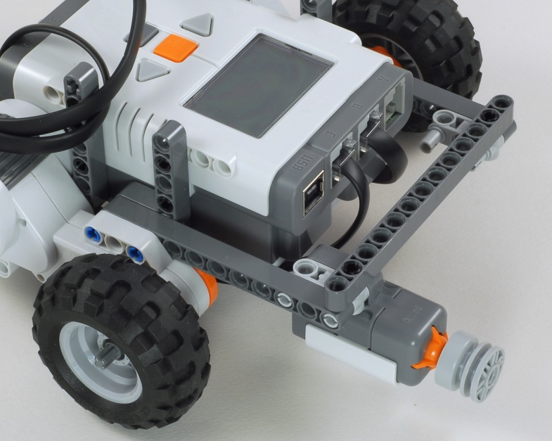
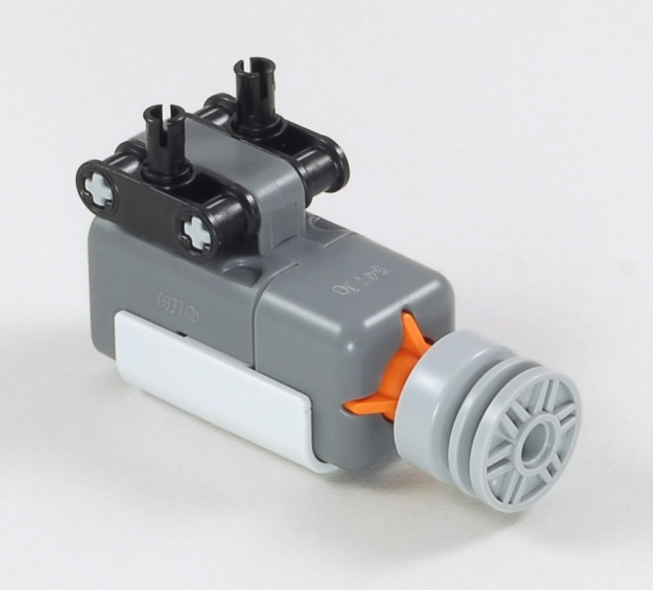
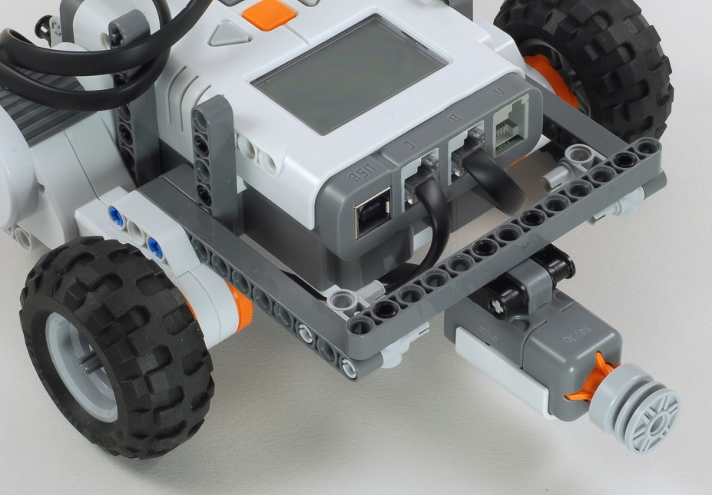
Express-Bot
Touch Sensor
Side
Center
The Express-Bot design may be freely used and redistributed. Design by www.nxtprograms.com.

Slide 5
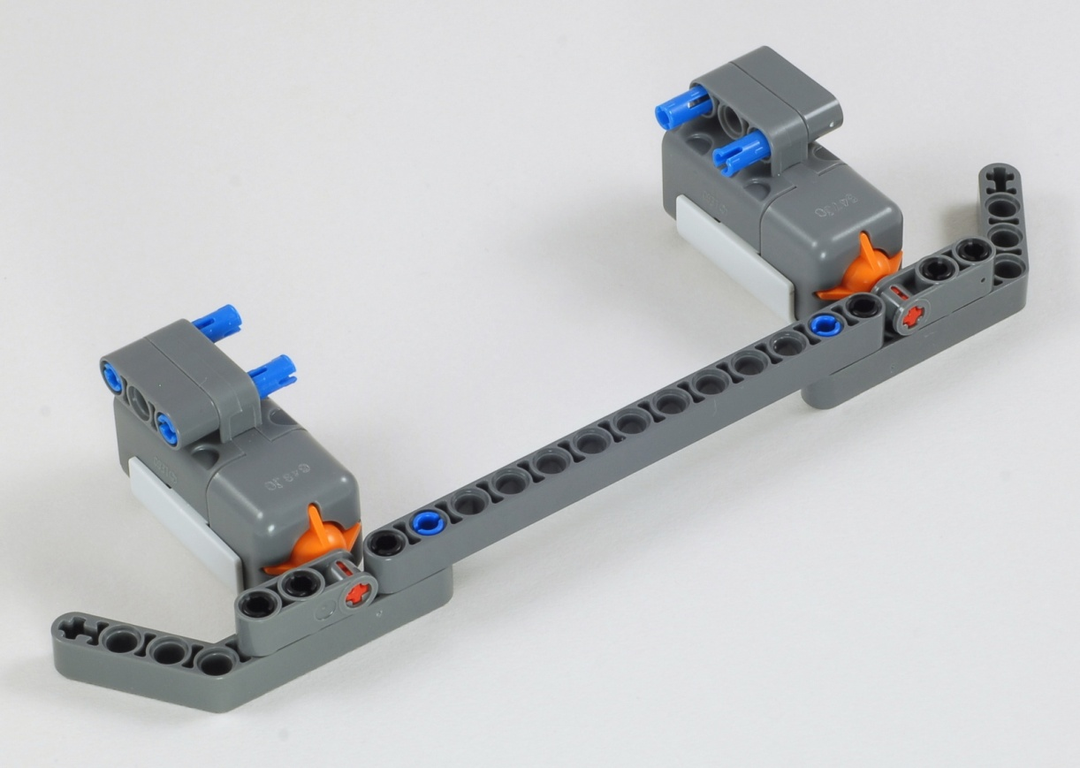
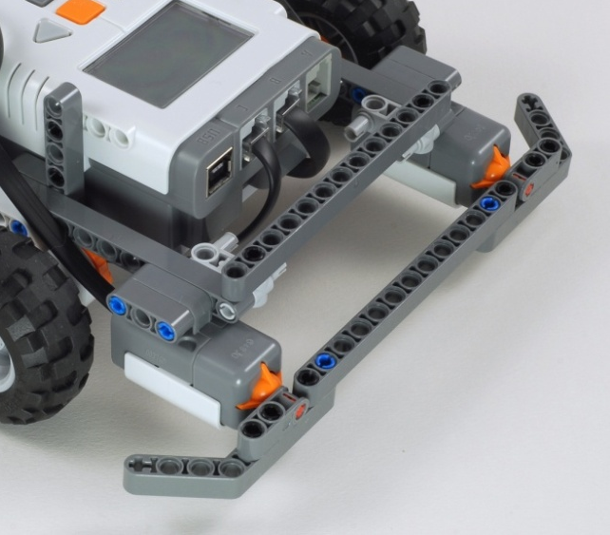
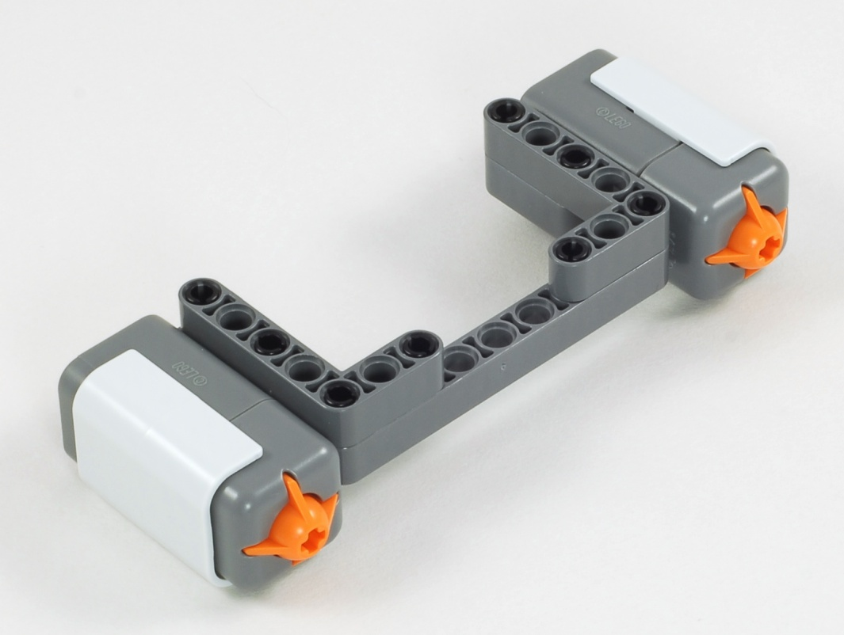
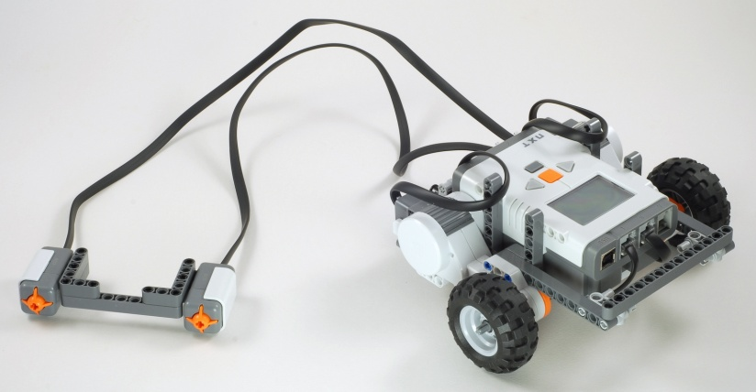
Express-Bot
Double Touch Sensor
Double Touch Sensor Bumper
Two-Button Remote Control
The Express-Bot design may be freely used and redistributed. Design by www.nxtprograms.com.

Slide 6
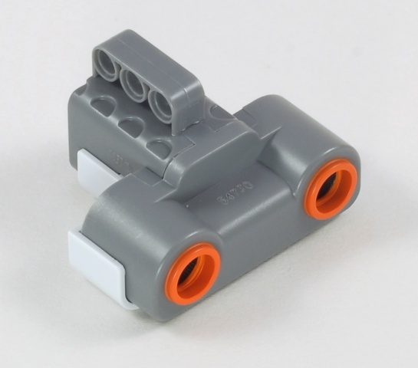
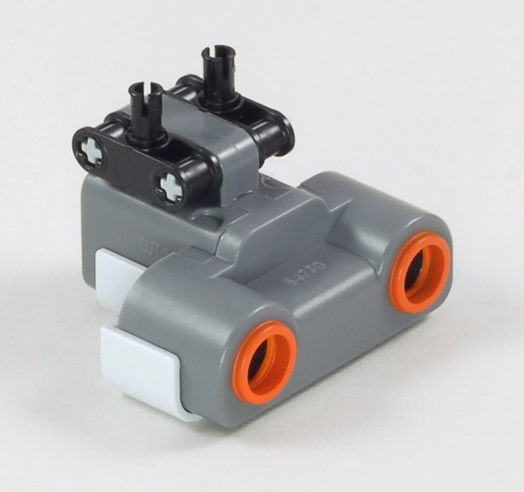
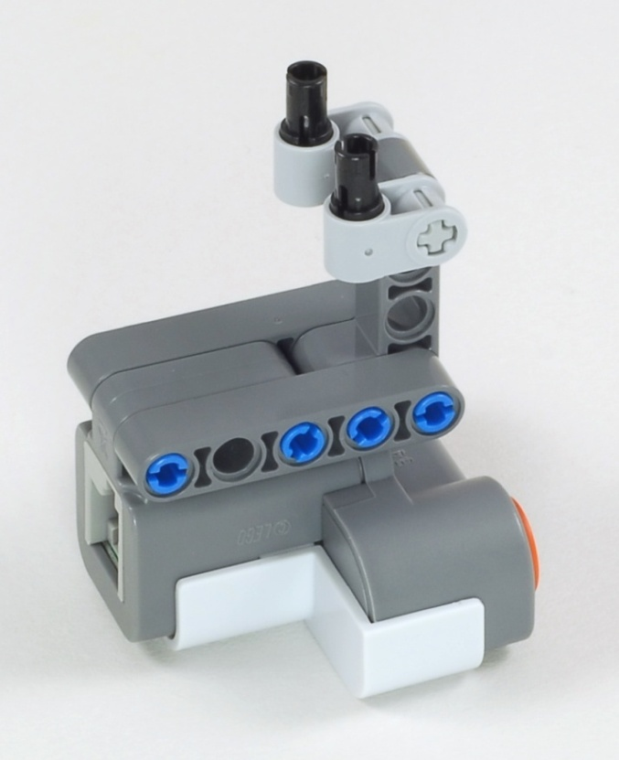
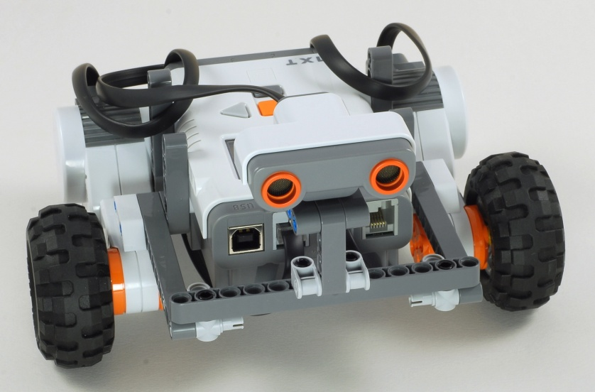
Express-Bot
Ultrasonic Sensor
Low/Side
Low/Center
Middle
High
The Express-Bot design may be freely used and redistributed. Design by www.nxtprograms.com.

Slide 7
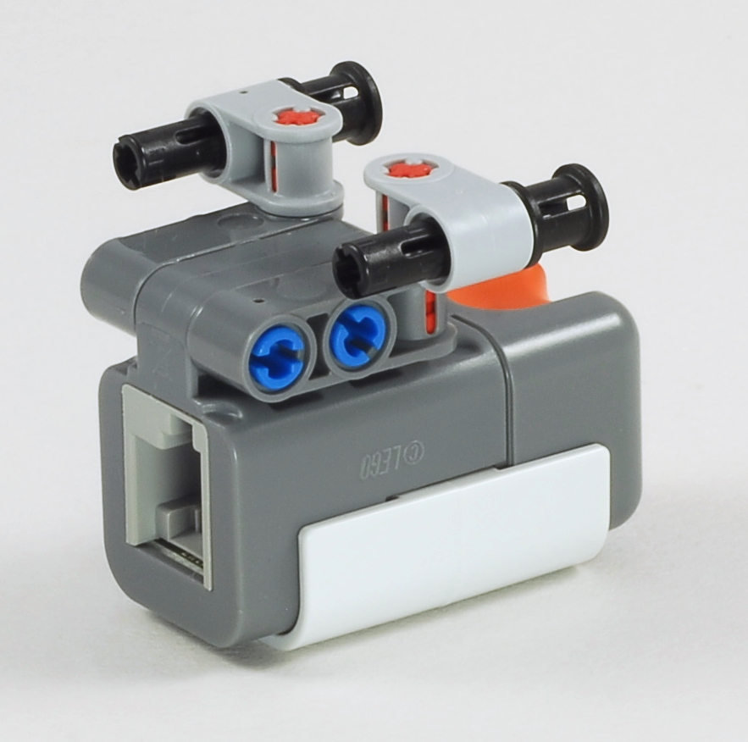
Express-Bot
Light Sensor, Downward
(Bottom View)
The Express-Bot design may be freely used and redistributed. Design by www.nxtprograms.com.

Slide 8
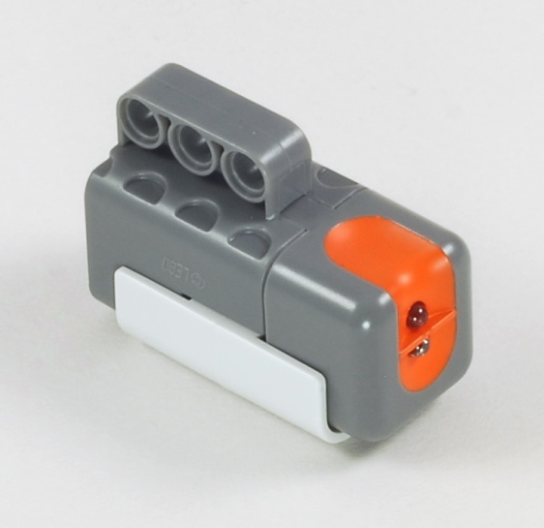
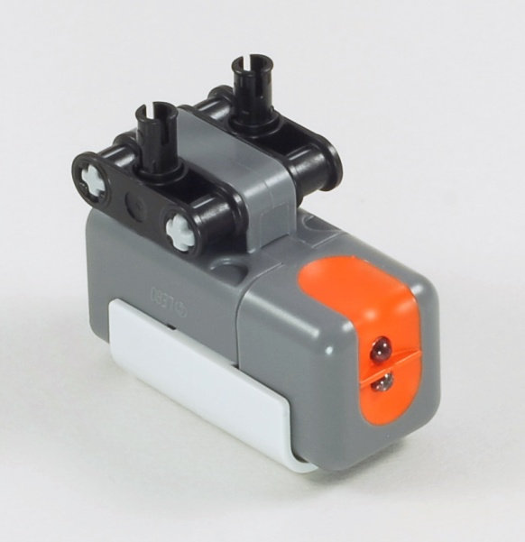
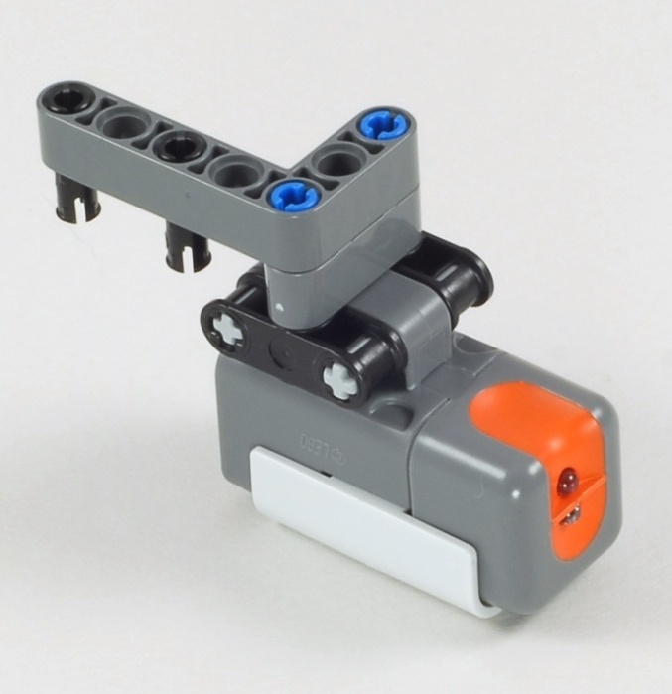
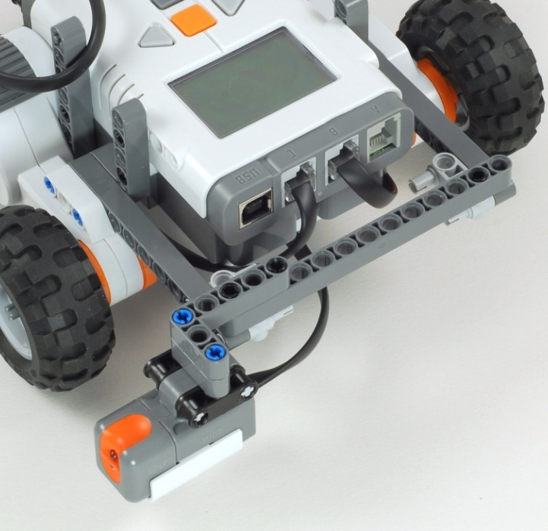
Express-Bot
Light Sensor, Horizontal
Side
Center
Sideways
The Express-Bot design may be freely used and redistributed. Design by www.nxtprograms.com.

Slide 9
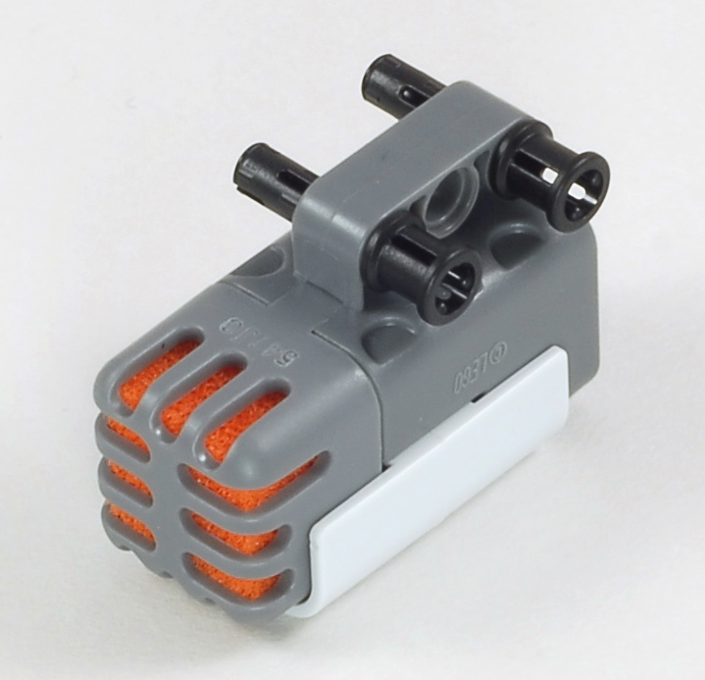
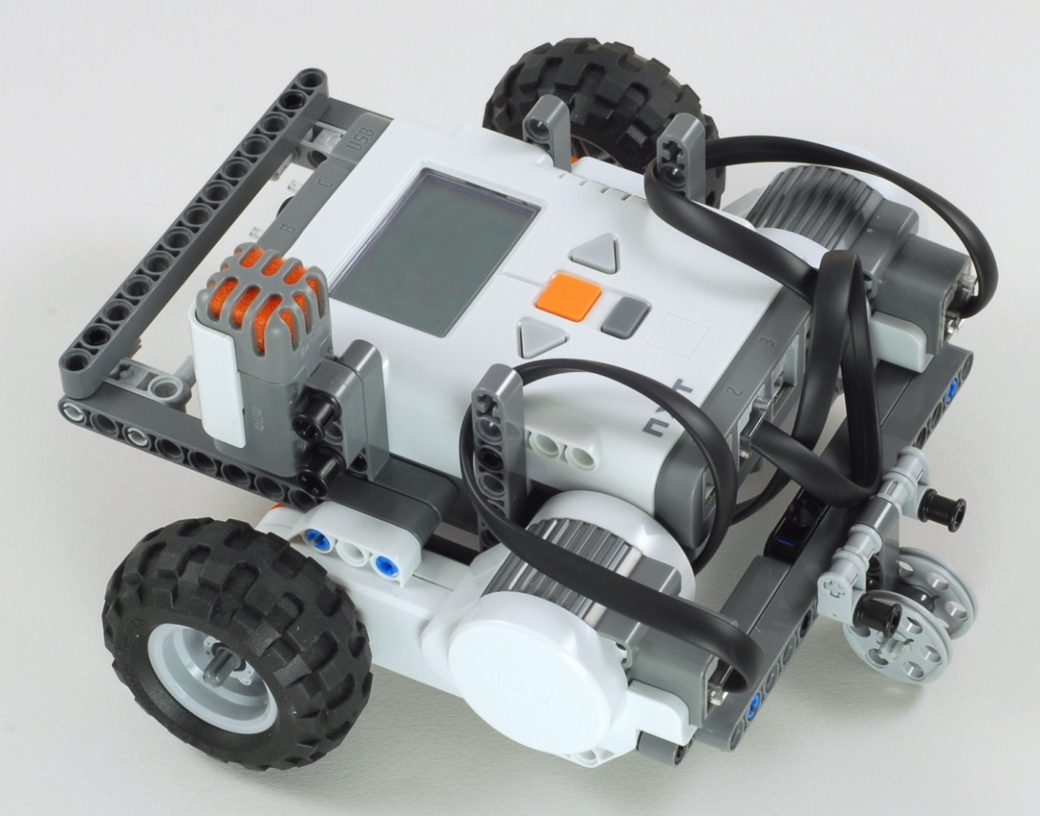
Express-Bot
Sound Sensor
The Express-Bot design may be freely used and redistributed. Design by www.nxtprograms.com.

Slide 10
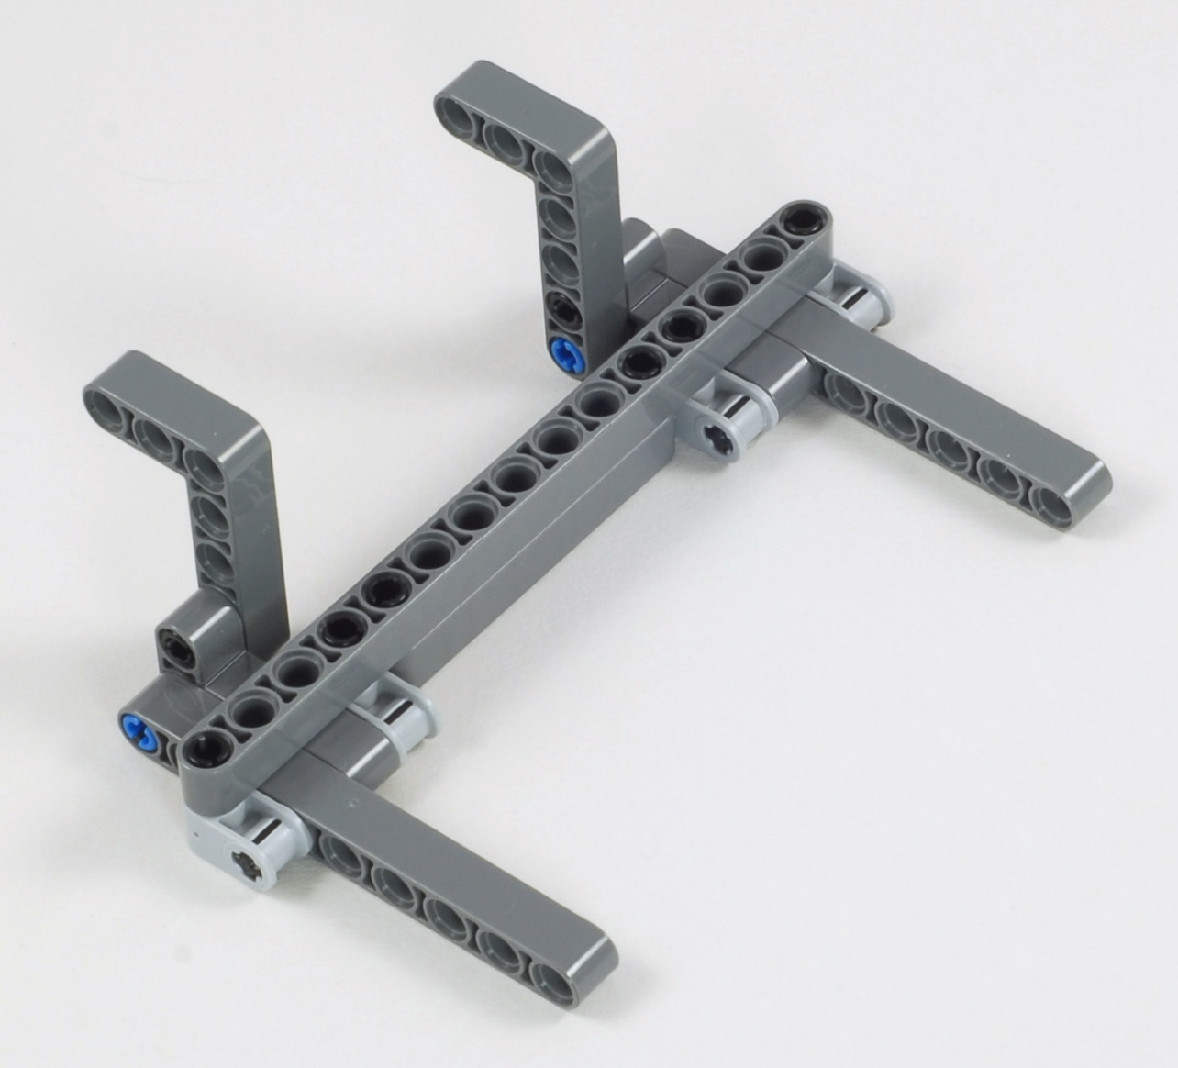
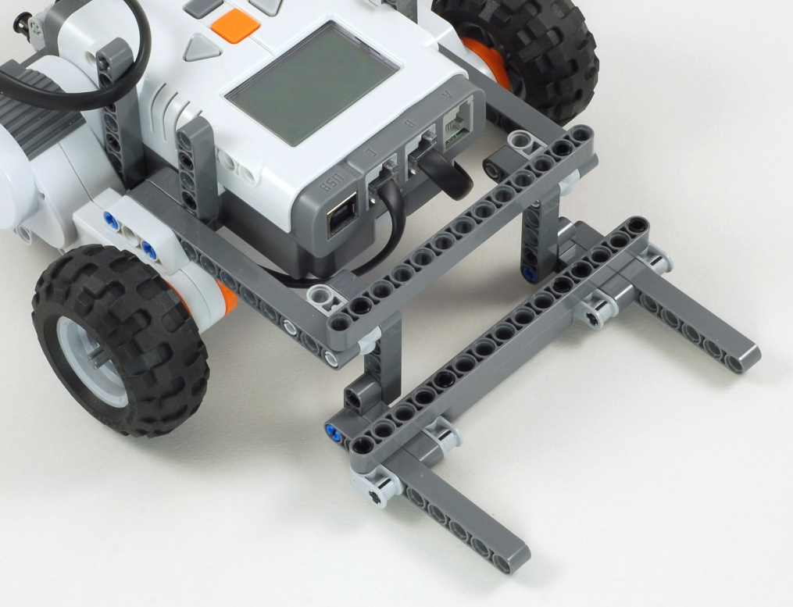
Express-Bot
Pusher
The Express-Bot design may be freely used and redistributed. Design by www.nxtprograms.com.

Slide 11
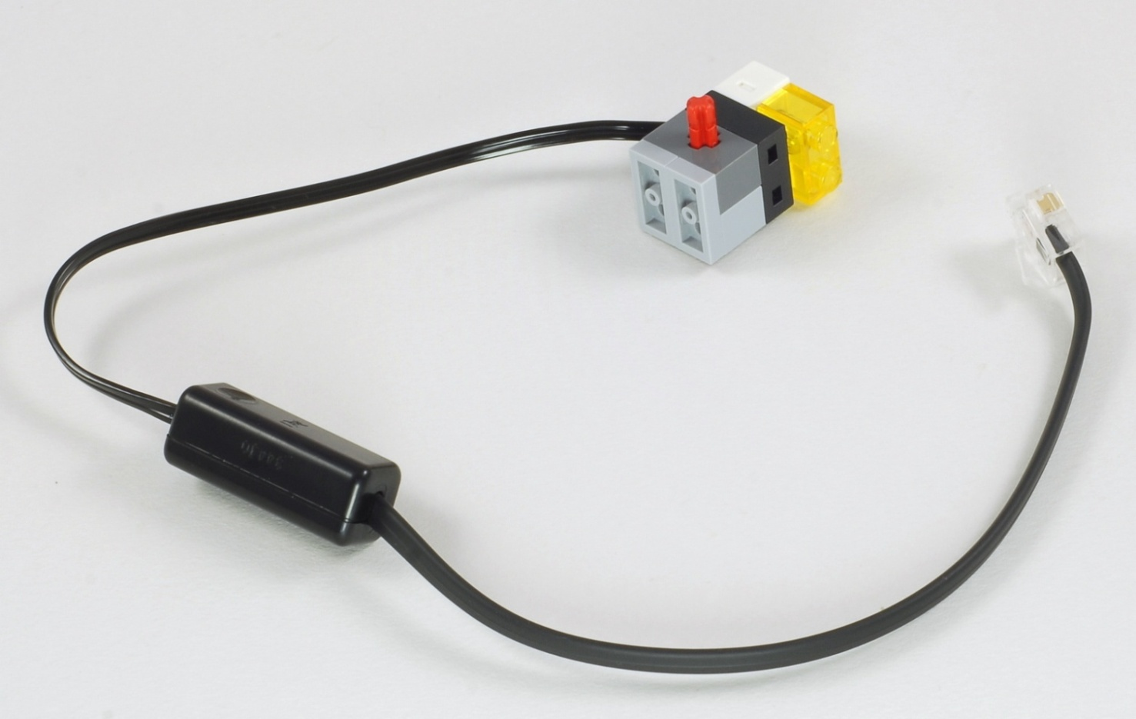
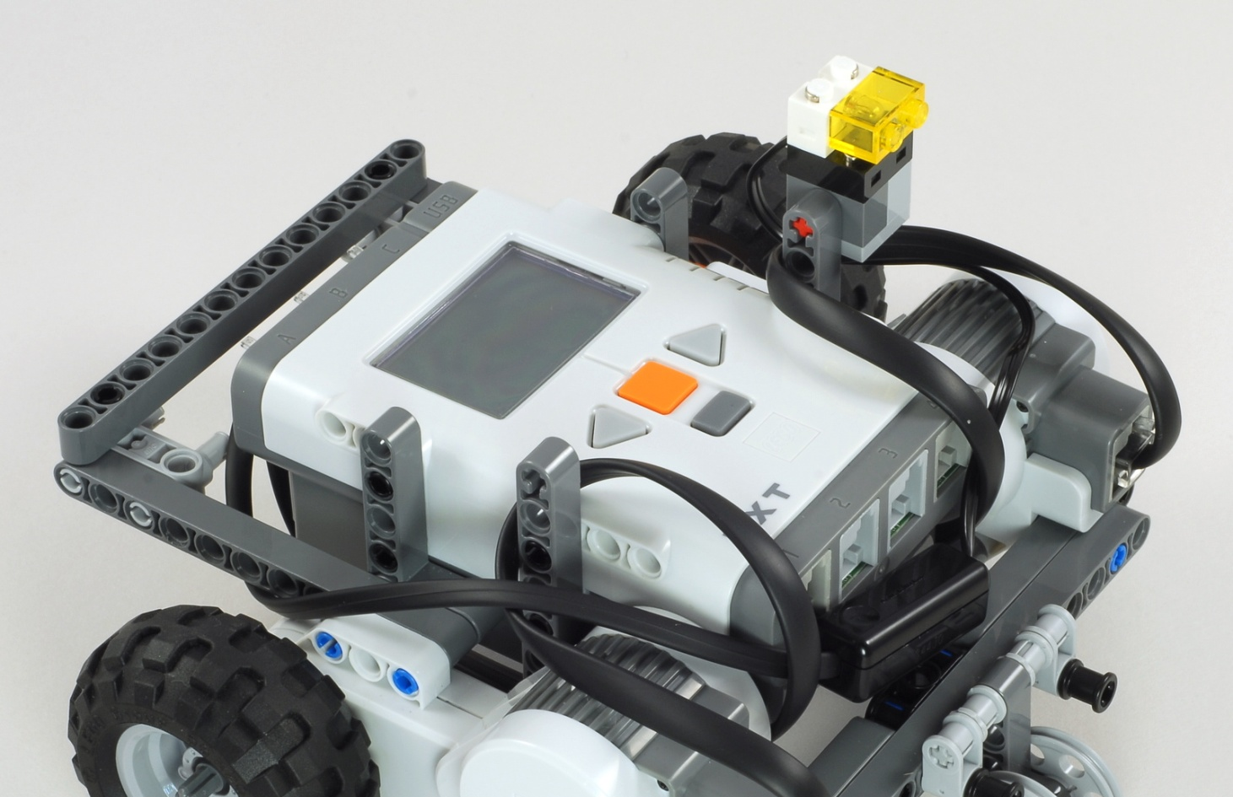
Express-Bot
Lamp
The Express-Bot design may be freely used and redistributed. Design by www.nxtprograms.com.

Slide 12
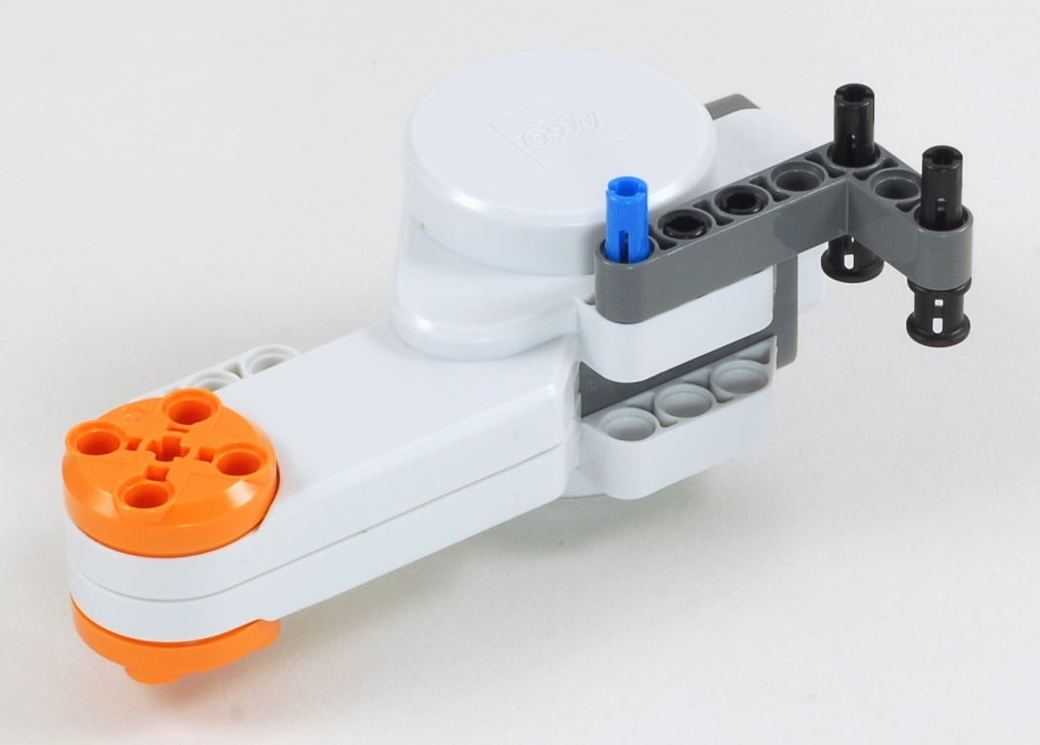
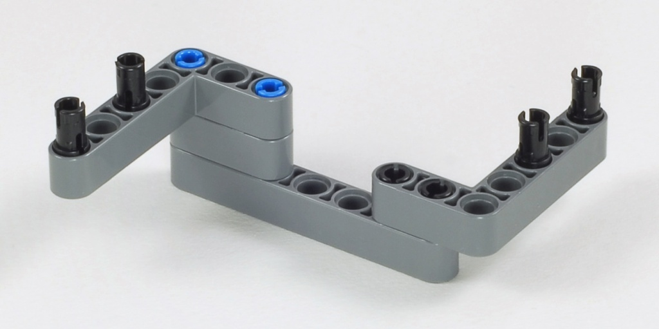
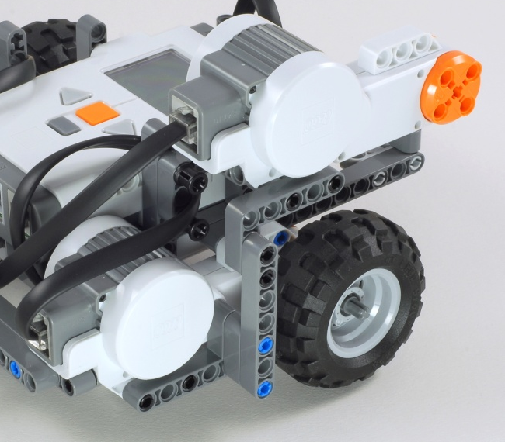
Express-Bot
Vertical Motor
Optional Motor Brace
Reinforces motor attachment
The Express-Bot design may be freely used and redistributed. Design by www.nxtprograms.com.

Slide 13
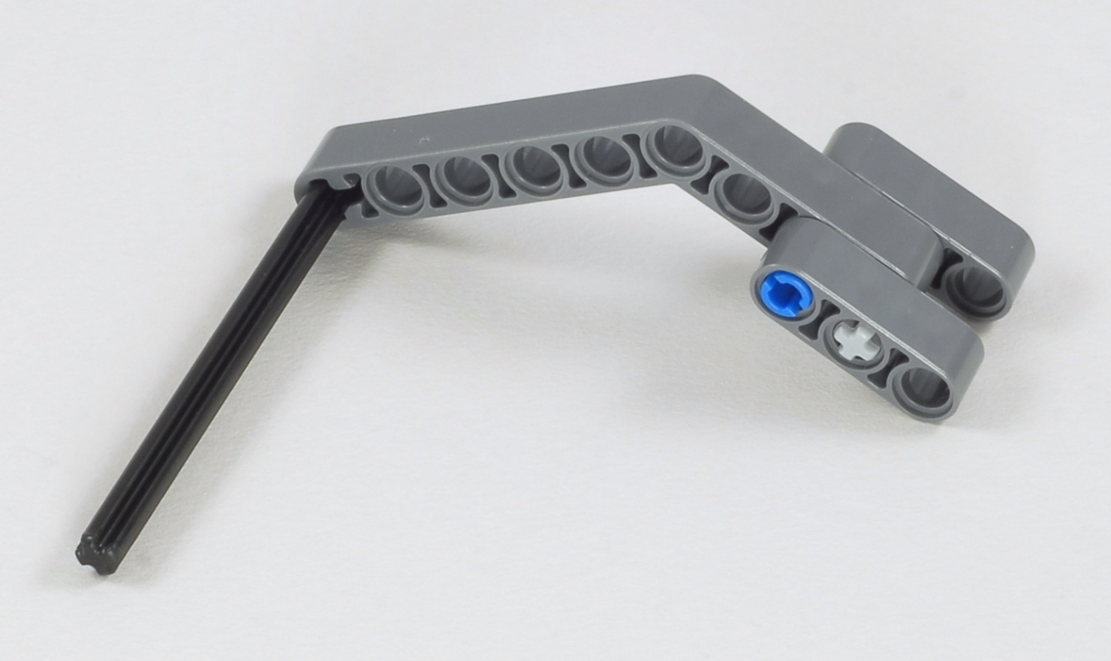
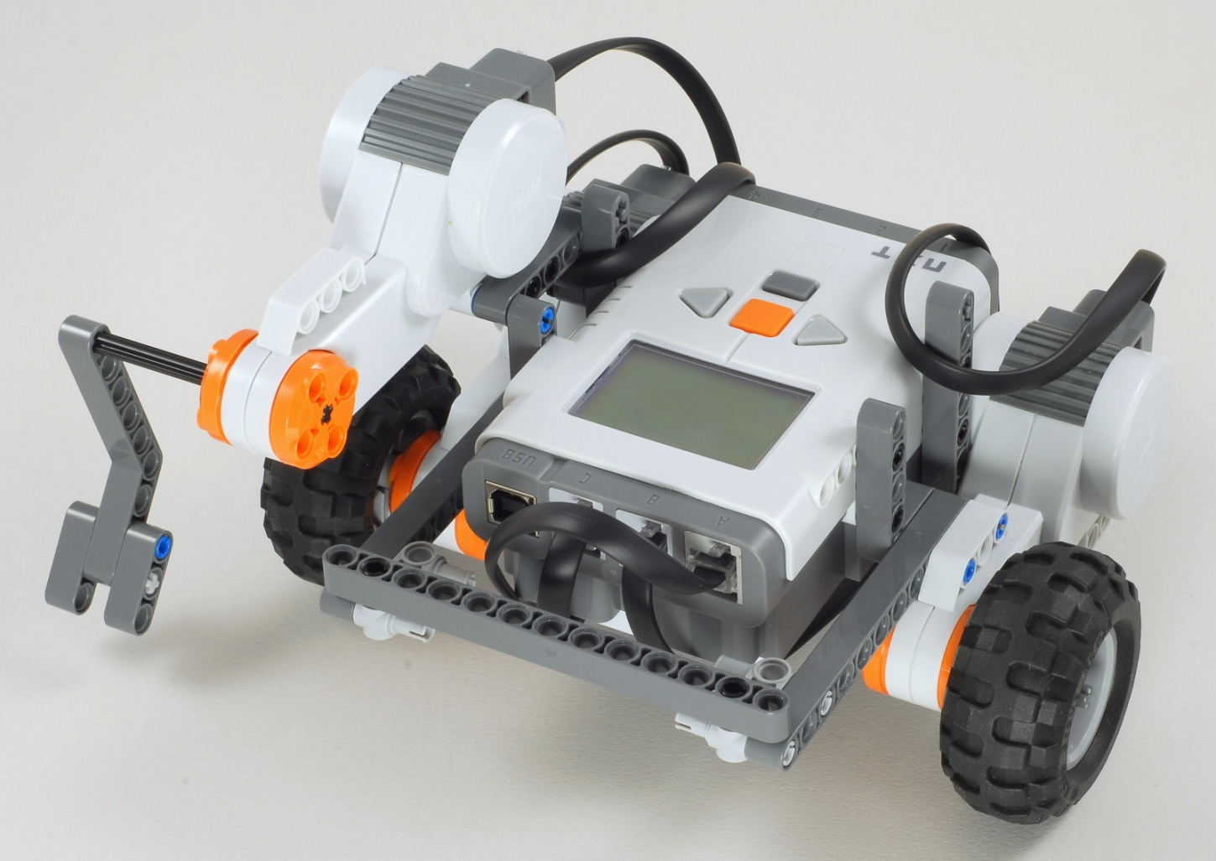
Express-Bot
Kicker
With Vertical Motor
The Express-Bot design may be freely used and redistributed. Design by www.nxtprograms.com.

Slide 14
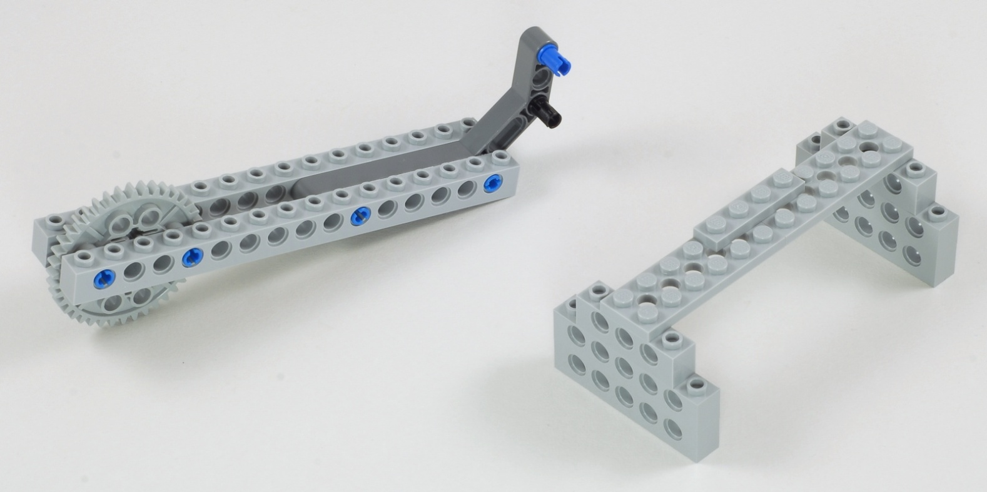
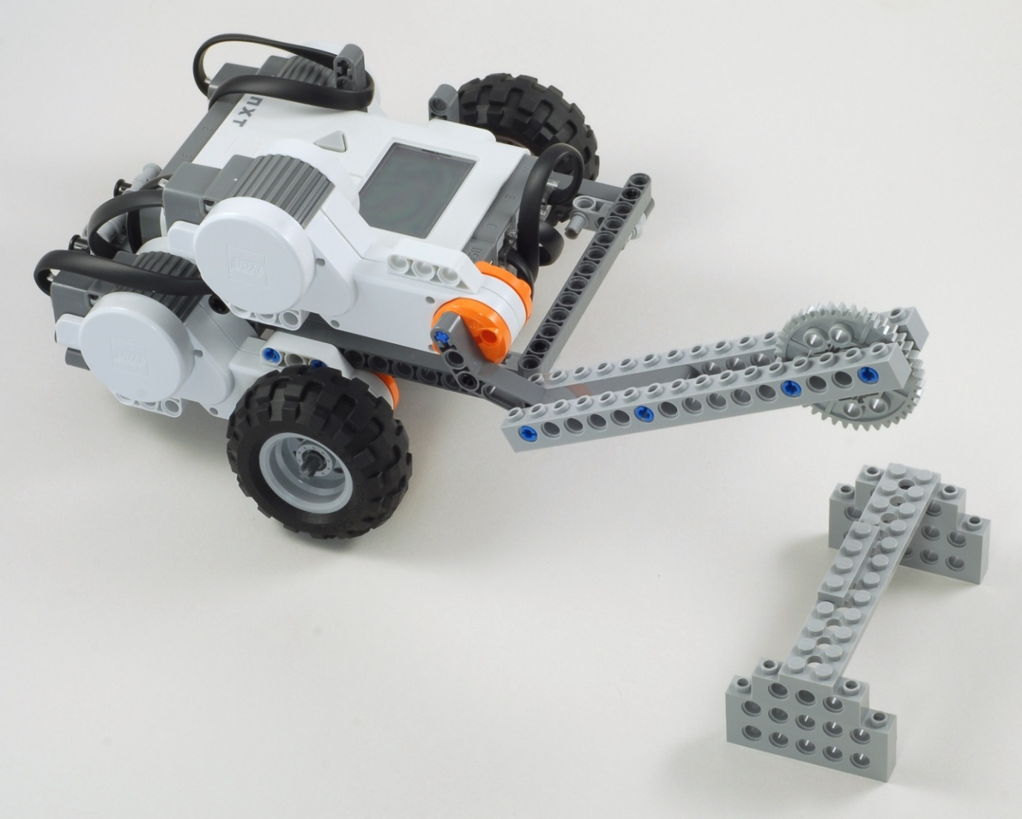
Express-Bot
Karate Arm and Chopping Block
With Vertical Motor
The Express-Bot design may be freely used and redistributed. Design by www.nxtprograms.com.

Slide 15
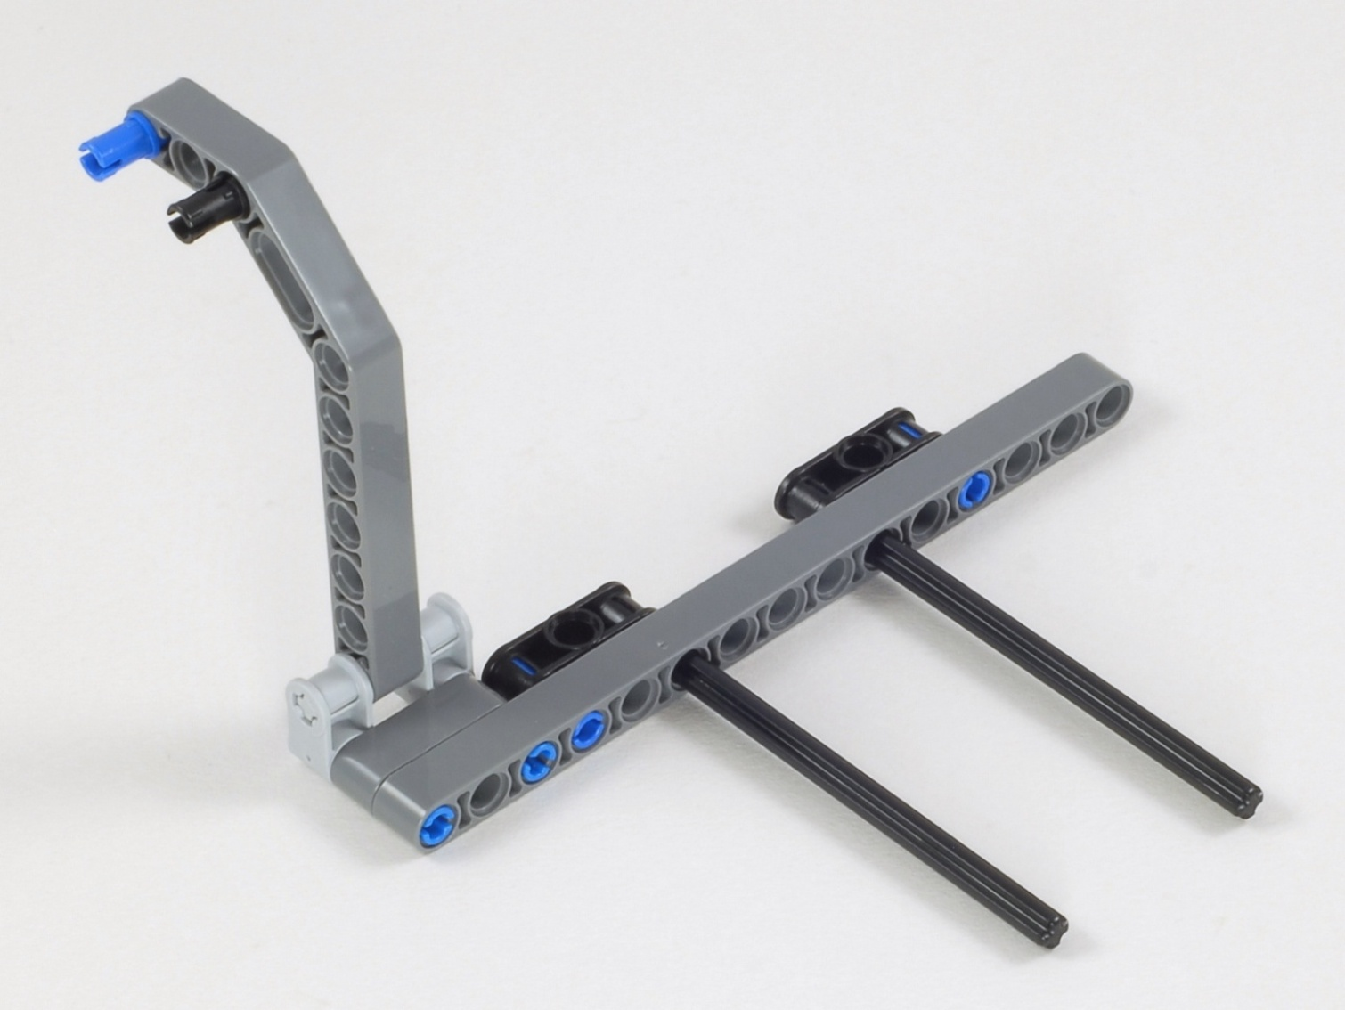
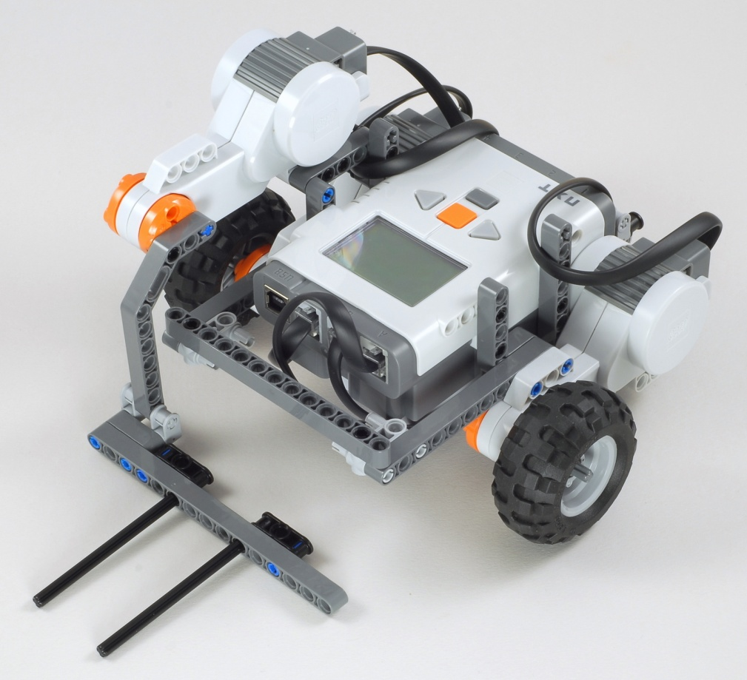
Express-Bot
Forklift Arm
With Vertical Motor
The Express-Bot design may be freely used and redistributed. Design by www.nxtprograms.com.

Slide 16
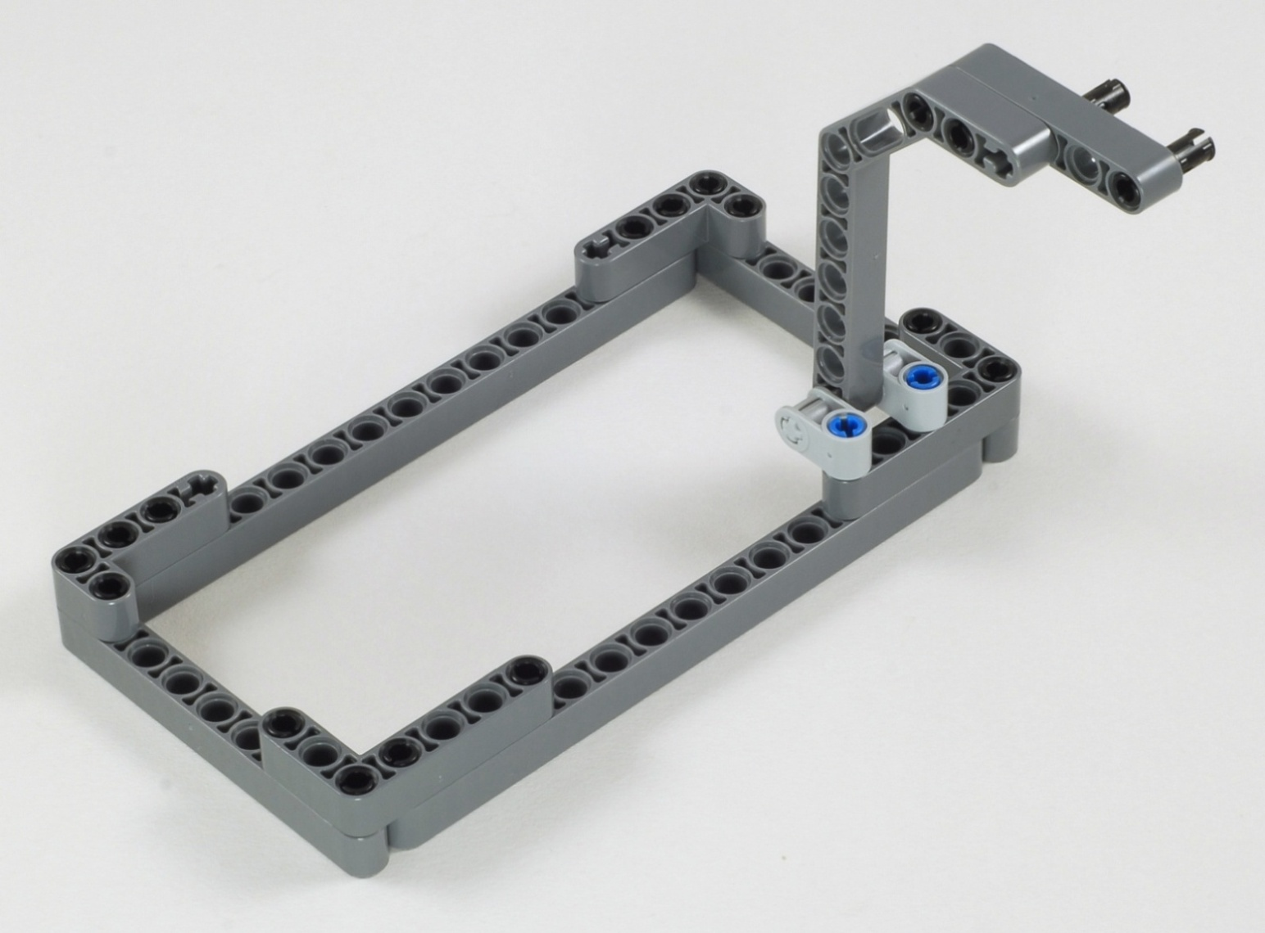
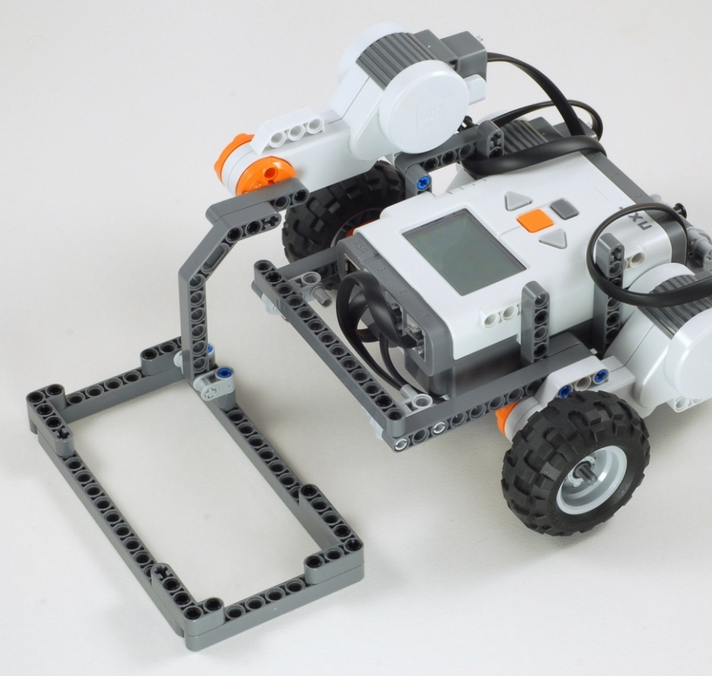
Express-Bot
Box Trap
With Vertical Motor
The Express-Bot design may be freely used and redistributed. Design by www.nxtprograms.com.

Slide 17
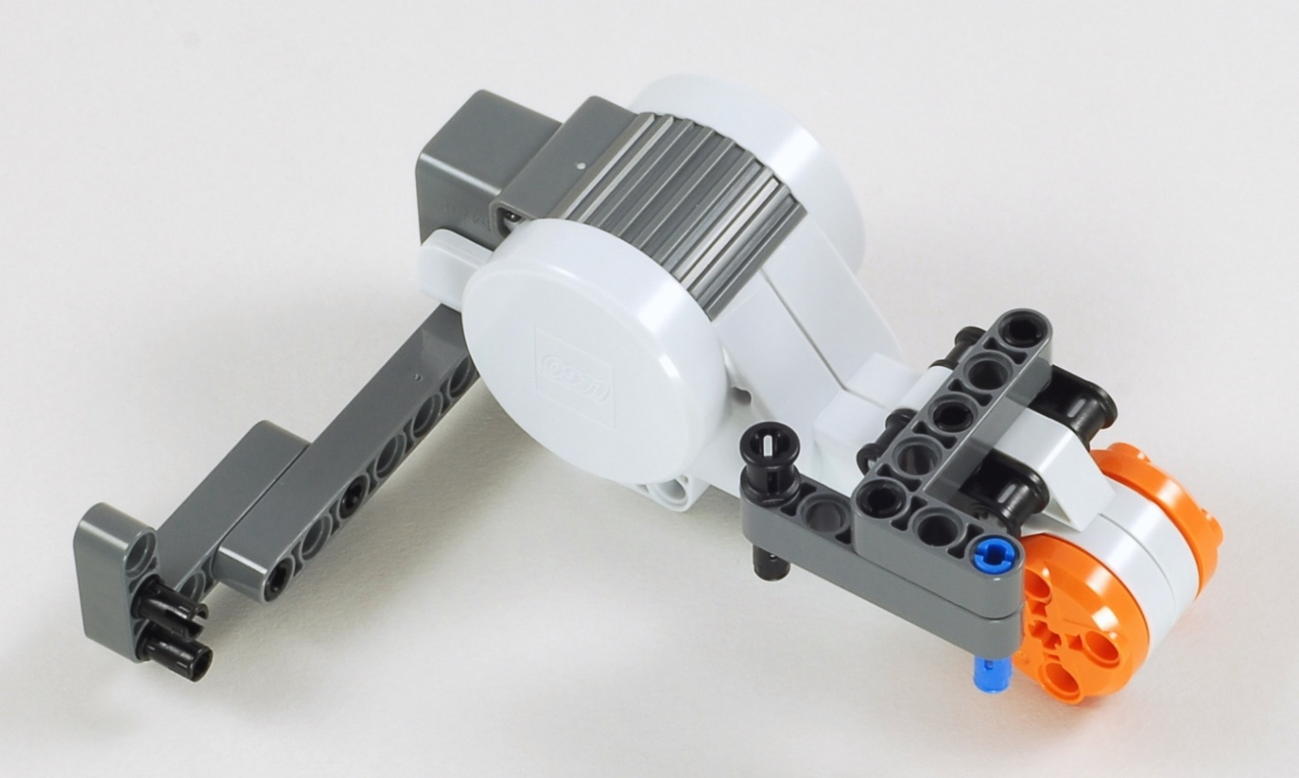
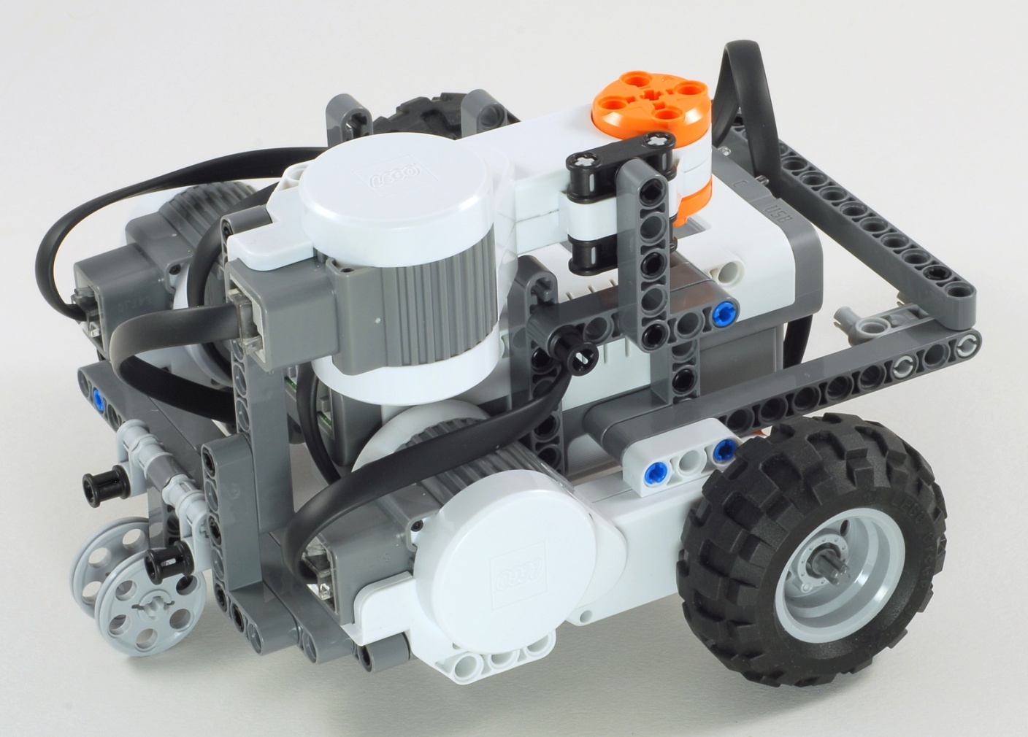
Express-Bot
Horizontal Motor
The Express-Bot design may be freely used and redistributed. Design by www.nxtprograms.com.

Slide 18
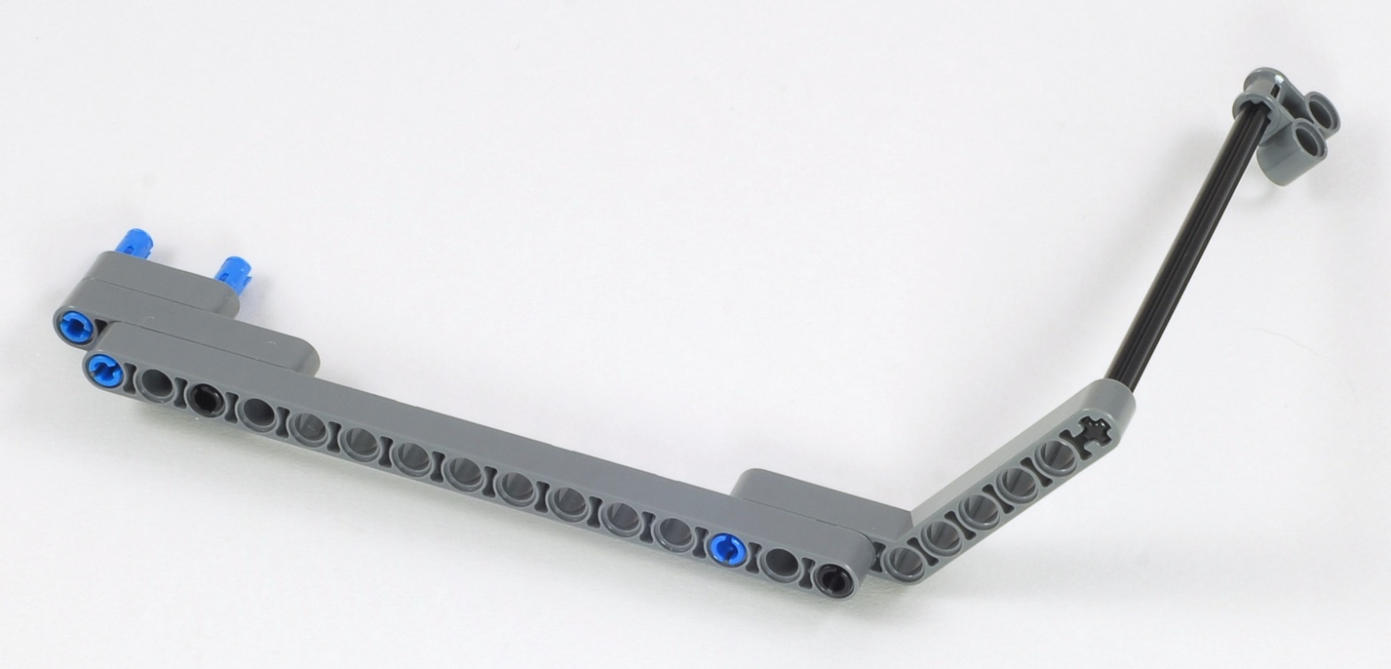
Express-Bot
Long Arm
With Vertical Motor
With Horizontal Motor
The Express-Bot design may be freely used and redistributed. Design by www.nxtprograms.com.

Slide 19
Express-Bot
Driver
The Express-Bot design may be freely used and redistributed. Design by www.nxtprograms.com.

Slide 20
Express-Bot
Forklift Objects
Ball Pallet
Tree
Barbell
The Express-Bot design may be freely used and redistributed. Design by www.nxtprograms.com.

Slide 21
Express-Bot
Game Objects
Boxes and Barrels
Ball Stand
Pivoting Flag
The Express-Bot design may be freely used and redistributed. Design by www.nxtprograms.com.

